Slide 1
Corporate Finance for
Long-Term Value
Chapter 19: Options

Slide 2
Chapter 19: Options
Part 5: Corporate financial policies

Slide 3
The BIG Picture
Options are contracts that give the owner the right to buy or sell a security at a pre-specified price
Discussion
Financial options can be used to deal with uncertainty (e.g. declining price)
A real option is the opportunity to make a particular business decision, exemplifying the value of flexibility
Real options on F can have E or S drivers: payoff in terms of F, but with E or S as the underlying values
Companies have a lot of put options against society, but awareness of them is low: this calls for integrated value expressed in real options

Slide 4
Financial options
Financial options are option contracts that give their owners the right to sell or buy a security from the writer of the contract at a specified price
The two parties to the contract have opposite positions:
  The buyer (owner) is long the option and has a right (not obligation) to buy or sell
  The seller (writer) is short the option and has the obligation to fulfil the contract
The owner pays a price for the option to the seller, known as the option premium
Two types of options:
  Call options, which gives the owner the right to buy a security
  Put options, which gives the owner the right to sell a security
exercise / strike price
Security can be:
company stock, exchange rate, interest rate, commodity, etc.

Slide 5
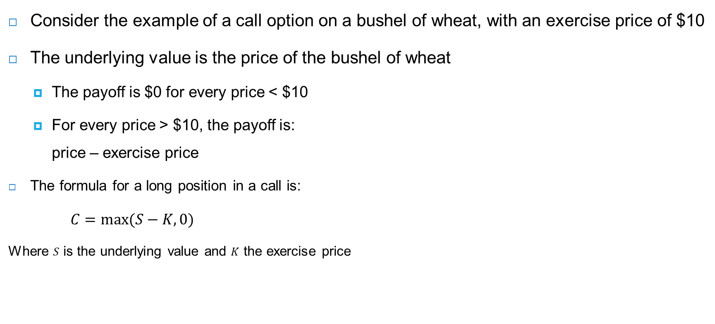
Call option – long
Consider the example of a call option on a bushel of wheat, with an exercise price of $10
The underlying value is the price of the bushel of wheat
  The payoff is $0 for every price < $10
  For every price > $10, the payoff is:
  price – exercise price
The formula for a long position in a call is:
$C=max⁡(S−K,0)$
Where $S$ is the underlying value and $K$ the exercise price
Payoff at > $10
Payoff at < $10

Slide 6
Call option – long (with premium)
The longer the maturity of the call, the higher the probability that the underlying value will at some time exceed the strike price and the higher its value
Since it has value, investors will be willing
to pay a price for it, called a premium
Suppose the premium for a bushel of wheat
is $0.40, then the payoff structure becomes →
Note that premiums are not fixed: they move
with the price of the underlying security
The buyer pays the premium to the seller at the time both parties enter into the contract, at which time the premium payment is fixed
Payoff at > $10
Break-even point: $10.40
Payoff at < $10

Slide 7

Call option – short
The seller, who writes the call, has the exact opposite payoff profile to the buyer
  The payoff is $0 for every price < $10
  For every price > $10, the payoff is:
  - (price – exercise price)
  The formula for a short position in a call is:
$−C=−max⁡(S−K,0)$
Where $S$ is the underlying value and $K$ the exercise price
Payoff at < $10
Payoff at > $10
Including $0.40 premium

Slide 8
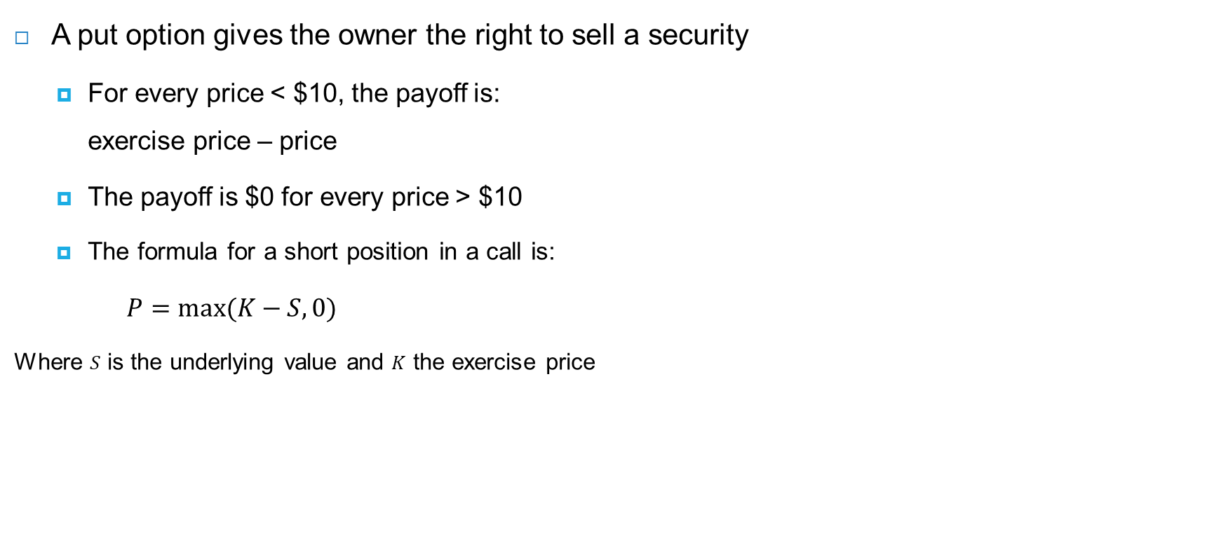
Put option – long
A put option gives the owner the right to sell a security
  For every price < $10, the payoff is:
  exercise price – price
  The payoff is $0 for every price > $10
  The formula for a short position in a call is:
$P=max⁡(K−S,0)$
Where $S$ is the underlying value and $K$ the exercise price
Payoff at < $10
Payoff at > $10

Slide 9
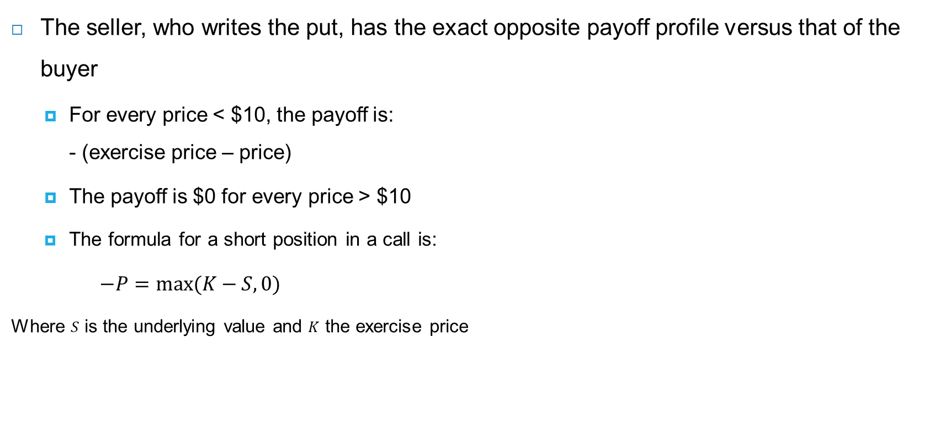
Put option – short
The seller, who writes the put, has the exact opposite payoff profile versus that of the buyer
  For every price < $10, the payoff is:
  - (exercise price – price)
  The payoff is $0 for every price > $10
  The formula for a short position in a call is:
$−P=max⁡(K−S,0)$
Where $S$ is the underlying value and $K$ the exercise price
Payoff at > $10
Payoff at < $10

Slide 10
Combinations of options & hedging
In practice people can have composite exposures: they may use options to hedge their exposures
Example: a farmer has a profit which depends on the wheat price
  Costs are $5 per bushel, so profit is: wheat price - $5 (left graph)
  By buying the put option with exercise price $10, the farmer gets protection against losses (middle graph)
  The farmer’s payoff: profit before hedging (S - $5) plus the put’s payoff (max[K-S,0]) minus the put’s premium:
  (S - $5) + max(K-S,0) - $0.40 → at all prices below $10, profit is locked in at $4.60 ← farmer buys protection at a cost of $0.40
Farmer profit before hedging
Put option (including premium)
Farmer profit after hedging

Slide 11
Combinations of options & hedging
A producer of packaged food faces an (almost) opposite exposure
The price per bushel hurts its profits since the food company needs to buy wheat for its production
  Profit per bushel: $17 – price per bushel (left graph)
  By buying a call option with exercise price $10, the food company gets protection against losses (middle graph)
  The food company’s payoff: profit before hedging ($17 - S) plus the call’s payoff (max[S-10,0]) minus the put’s premium:
  ($17 - S) + max(S-10,0) - $0.40 → at all prices above $10, profit is locked in at $6.60 ← company buys protection at a cost of $0.40
Food co profit before hedging
Call option (including premium)
Food co profit after hedging

Slide 12
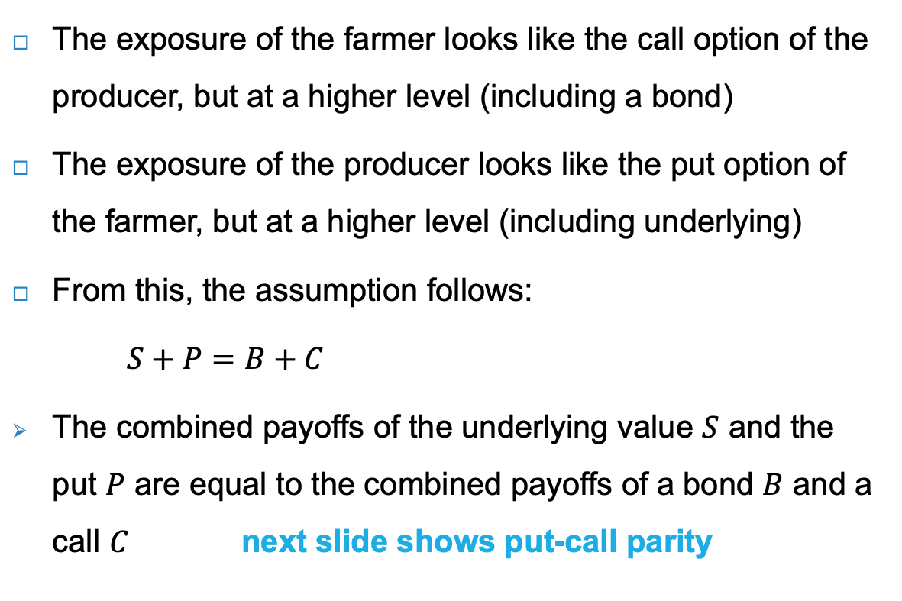
Put-call parity
The exposure of the farmer looks like the call option of the producer, but at a higher level (including a bond)
The exposure of the producer looks like the put option of the farmer, but at a higher level (including underlying)
From this, the assumption follows:
$S+P=B+C$
The combined payoffs of the underlying value $S$ and the put $P$ are equal to the combined payoffs of a bond $B$ and a call $C$ next slide shows put-call parity

Slide 13
Put-call parity expressed in payoff structures
S (stock)
P (put)
S+P=B+C
B (bond)
C (call)

Slide 14
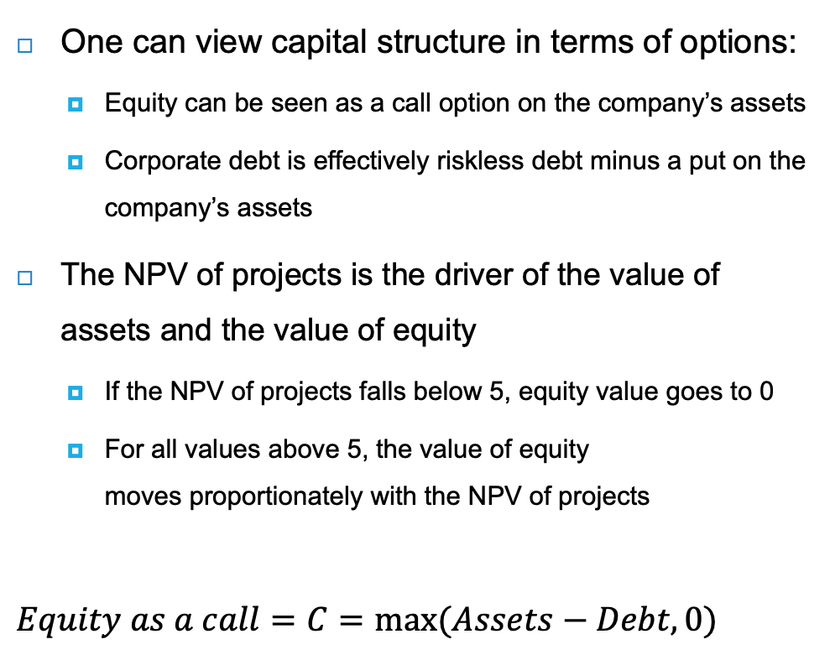
Capital structure expressed in options
One can view capital structure in terms of options:
  Equity can be seen as a call option on the company’s assets
  Corporate debt is effectively riskless debt minus a put on the company’s assets
The NPV of projects is the driver of the value of assets and the value of equity
  If the NPV of projects falls below 5, equity value goes to 0
  For all values above 5, the value of equity
  moves proportionately with the NPV of projects
$$Equity as a call=C=max⁡(Assets−Debt,0)$$
NPV of projects | 20 |  | Debt | 5
 |  |  | Equity | 15
Total assets | 20 |  | Total liabilities | 20
Value of equity at the current value of the company (20) and a strike price (value of debt) of 5

Slide 15
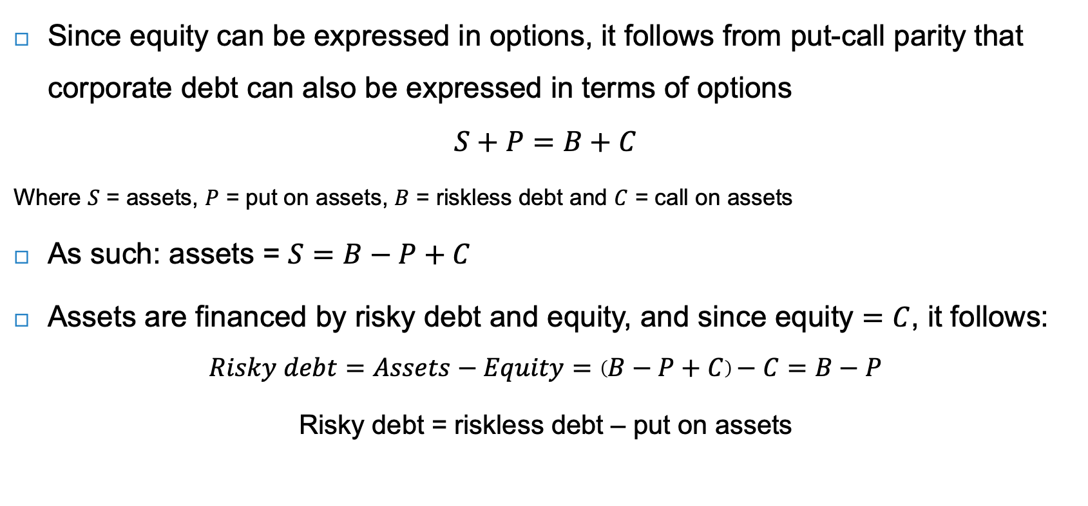
Corporate debt in terms of options
Since equity can be expressed in options, it follows from put-call parity that corporate debt can also be expressed in terms of options
$$S+P=B+C$$
Where $S$ = assets, $P$ = put on assets, $B$ = riskless debt and $C$ = call on assets
As such: assets = $S=B−P+C$
Assets are financed by risky debt and equity, and since equity $=C$, it follows:
$$Risky debt=Assets−Equity=\left(B−P+C\right)−C=B−P$$
Risky debt = riskless debt – put on assets

Slide 16
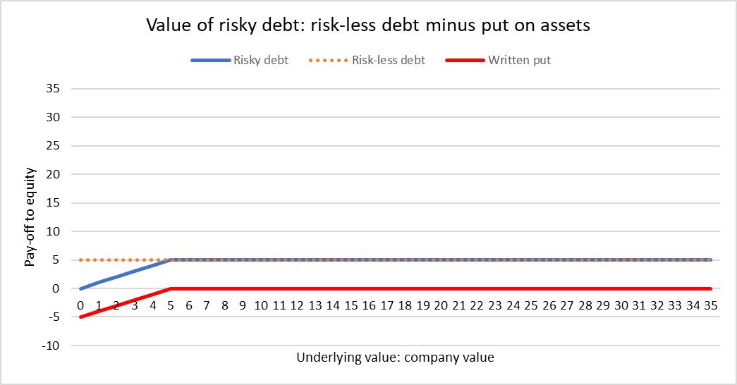
Corporate debt in terms of options
Value of risky debt is 5 at the current value of the company (20) and a strike price of the put of 5
Below a company value of 5, the written put has a negative payoff

Slide 17
Option quotations
Options are most commonly traded on stocks
  Example of 3M stock with 3 strike prices
Strike price is the fixed price at which the owner of the option can by or sell the underlying security
Bid price is the price at which the market-makers are willing to buy the option
Ask price is the price at which the market-makers are willing to sell the option
Open interest refers to the number of option contracts that are held by traders in active positions
Strike* | C or P | Bid* | Ask* | Open interest
60 | C | 53.50 | 55.55 | 0
 | P | 2.97 | 3.90 | 20
110 | C | 20.50 | 21.75 | 17
 | P | 16.90 | 18.00 | 64
160 | C | 5.65 | 6.45 | 25
 | P | 49.15 | 50.70 | 2
* Per October 2022, with expiration in January 2025

Slide 18

Option quotations
As of October 2022, 3M stock was $113.45
$Option value=intrinsic value+time value$
(see next slide)
At $60, the call option is very much ‘in-the-money’, whereas the put option is ‘out-of-the-money’
The difference between the stock price and exercise price is the intrinsic value of the option
  For $60 call option: $113.45 - $60 = $53.45
  For $60 put option: $60 - $113.45 = 0
The average of the bid and ask is the option value
The option value minus the intrinsic value is called the time value of the option
  For $60 call: ($55.55 + $53.50) / 2 = $54.53 - $53.45 = $1.08
  For $60 put option: ($3.90 - $2.97) / 2 = $3.44 - $0 = $3.44
Strike* | C or P | Bid* | Ask* | Open interest
60 | C | 53.50 | 55.55 | 0
 | P | 2.97 | 3.90 | 20
110 | C | 20.50 | 21.75 | 17
 | P | 16.90 | 18.00 | 64
160 | C | 5.65 | 6.45 | 25
 | P | 49.15 | 50.70 | 2
* Per October 2022, with expiration in January 2025

Slide 19
Option value = intrinsic value + time value

Slide 20
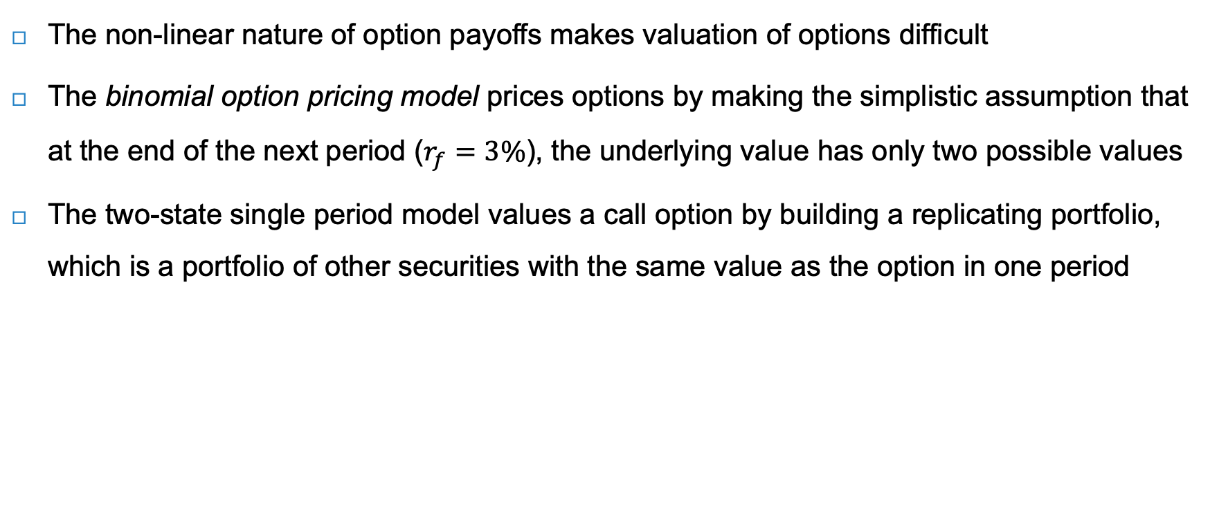
Valuing options
The non-linear nature of option payoffs makes valuation of options difficult
The binomial option pricing model prices options by making the simplistic assumption that at the end of the next period ($r_{f}=3\%$), the underlying value has only two possible values
The two-state single period model values a call option by building a replicating portfolio, which is a portfolio of other securities with the same value as the option in one period
Stock: Bond: Call:
$S_{u}$= $12 $B∙\left(1+r_{f}\right)$ = $1.03 $C_{u}$ = max($12-$10,$0) = $2
up
Stock: S = $10
Bond: B = $1
down
Stock: Bond: Call:
$S_{d}$= $8 $B∙\left(1+r_{f}\right)$ = $1.03 $C_{d}$ = max($8-$10,$0) = $0

Slide 21

Binomial model – step 1
The idea is to buy stock in such proportions that they give the same payoffs as the call
The first step is to determine the option delta $Δ$ (or hedge ratio), which is the number of stocks needed to replicate or hedge the call:
$Δ=\frac{\text{spread} \text{of} \text{possible} \text{option} \text{prices}}{\text{spread} \text{of} \text{possible} \text{stock} \text{prices}}=\frac{C_{u}−C_{d}}{S_{u}−S_{d}}=\frac{\$2−\$0}{\$12−\$8}=0.5$
Stock: Bond: Call:
$S_{u}$= $12 $B∙\left(1+r_{f}\right)$ = $1.03 $C_{u}$ = max($12-$10,$0) = $2
up
Stock: S = $10
Bond: B = $1
down
Stock: Bond: Call:
$S_{d}$= $8 $B∙\left(1+r_{f}\right)$ = $1.03 $C_{d}$ = max($8-$10,$0) = $0

Slide 22

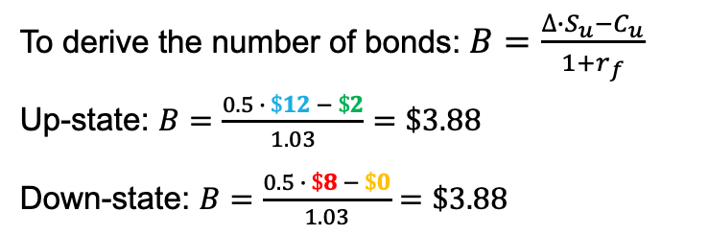
Binomial model – step 2
The second step is to determine the number of bonds needed to finance the stock position
The replication, for one time period later, is:
  For the up-state: $C_{u}=∆∙S_{u}−\left(1+r_{f}\right)∙B$
  For the down-state: $C_{d}=∆∙S_{d}−\left(1+r_{f}\right)∙B$
To derive the number of bonds: $B=\frac{∆∙S_{u}−C_{u}}{1+r_{f}}$
Up-state: $B=\frac{0.5 ∙ \$12 − \$2}{1.03}=\$3.88$
Down-state: $B=\frac{0.5 ∙ \$8 − \$0}{1.03}=\$3.88$
Stock: Bond: Call:
$S_{u}$= $12 $B∙\left(1+r_{f}\right)$ = $1.03 $C_{u}$ = max($12-$10,$0) = $2
up
Stock: S = $10
Bond: B = $1
down
Stock: Bond: Call:
$S_{d}$= $8 $B∙\left(1+r_{f}\right)$ = $1.03 $C_{d}$ = max($8-$10,$0) = $0

Slide 23

Binomial model – step 3
The final step is to determine the price of the call
The price of the call option in the binomial model is as follows:
Value of call = [delta x stock price] - [bonds]
$$C=∆∙S−B$$
$$C=0.5∙\$10−\$3.88=\$1.12$$
Stock: Bond: Call:
$S_{u}$= $12 $B∙\left(1+r_{f}\right)$ = $1.03 $C_{u}$ = max($12-$10,$0) = $2
up
Stock: S = $10
Bond: B = $1
down
Stock: Bond: Call:
$S_{d}$= $8 $B∙\left(1+r_{f}\right)$ = $1.03 $C_{d}$ = max($8-$10,$0) = $0

Slide 24
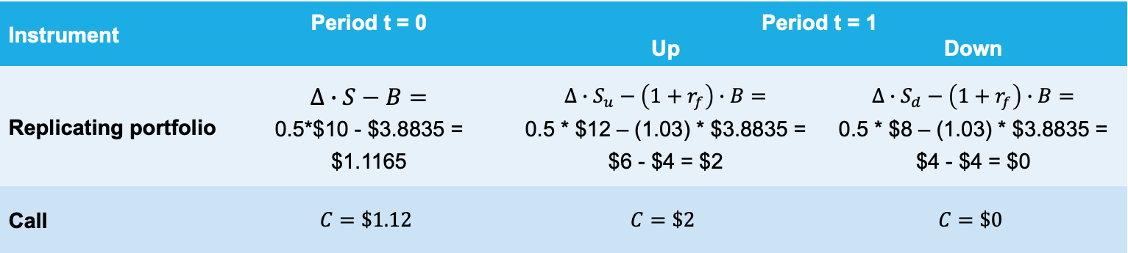
Binomial model – step 4 (overview)
Instrument | Period t = 0 | Period t = 1
 |  | Up | Down
Replicating portfolio | $$∆∙S−B=$$ 0.5*$10 - $3.8835 = $1.1165 | $$∆∙S_{u}−\left(1+r_{f}\right)∙B=$$ 0.5 * $12 – (1.03) * $3.8835 = $6 - $4 = $2 | $$∆∙S_{d}−\left(1+r_{f}\right)∙B=$$ 0.5 * $8 – (1.03) * $3.8835 = $4 - $4 = $0
Call | $$C=\$1.12$$ | $$C=\$2$$ | $$C=\$0$$
Stock: Bond: Call:
$S_{u}$= $12 $B∙\left(1+r_{f}\right)$ = $1.03 $C_{u}$ = max($12-$10,$0) = $2
up
Stock: S = $10
Bond: B = $1
down
Stock: Bond: Call:
$S_{d}$= $8 $B∙\left(1+r_{f}\right)$ = $1.03 $C_{d}$ = max($8-$10,$0) = $0

Slide 25

Put option in binomial model
The calculation of the put price occurs in a similar way to the call price
Option delta $Δ=\frac{\text{spread} \text{of} \text{possible} \text{option} \text{prices}}{\text{spread} \text{of} \text{possible} \text{stock} \text{prices}}=\frac{P_{u}−P_{d}}{S_{u}−S_{d}}$ $=\frac{\$0−\$2}{\$12−\$8}=−0.5$
Number of bonds $B=\frac{−∆∙S_{u}+P_{u}}{1+r_{f}}$ $=\frac{−\left(−0.5\right)∙\$12+\$0}{1.03}=\$5.83$
Value of put = [delta x stock price] + [bonds] = $P=∆∙S+B$ $=−0.5∙\$10+\$5.83=\$0.83$
Stock: Bond: Call:
$S_{u}$= $12 $B∙\left(1+r_{f}\right)$ = $1.03 $P_{u}$ = max($10-$12,$0) = $0
up
Stock: S = $10
Bond: B = $1
down
Stock: Bond: Call:
$S_{d}$= $8 $B∙\left(1+r_{f}\right)$ = $1.03 $P_{d}$ = max($10-$8,$0) = $2

Slide 26
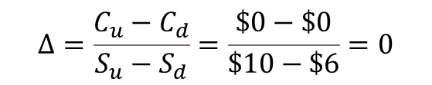
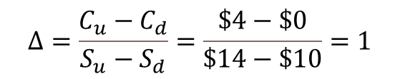
Multiperiod binomial model
The formula for the option delta Δ can be interpreted as the sensitivity of the option’s value to changes in the stock price at each point in time
We can value the call option in the multiperiod binomial tree by working backwards from t = 2
t = 0
t = 1
t = 2
Option deltas
up
$14
$$Δ=\frac{C_{u}−C_{d}}{S_{u}−S_{d}}=\frac{\$4−\$0}{\$14−\$10}=1$$
up
$12
down
S = $10
$10
up
down
$$Δ=\frac{C_{u}−C_{d}}{S_{u}−S_{d}}=\frac{\$0−\$0}{\$10−\$6}=0$$
$8
down
A call with zero payoffs in the future, also has zero value today
$6

Slide 27

Multiperiod binomial model
$B=\frac{∆∙S_{u}−C_{u}}{1+r_{f}}=\frac{1∙\$14−\$4}{1.03}=\$9.709$
$C=∆∙S−B=1∙\$12−\$9.709=\$2.291$
Value of call option in the up-state at t = 1
t = 0
t = 1
t = 2
up
$14
up
$12
down
S = $10
$10
up
down
$8
down
$6

Slide 28
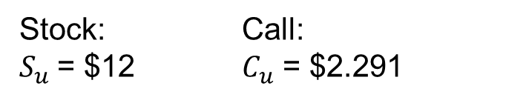

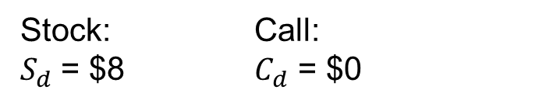
Multiperiod binomial model
$Δ=\frac{C_{u}−C_{d}}{S_{u}−S_{d}}=\frac{\$2.291−\$0}{\$12−\$8}=0.573$
$B=\frac{∆∙S_{u}−C_{u}}{1+r_{f}}=\frac{0.573∙\$12−\$2.291}{1.03}=\$4.449$
$C=∆∙S−B=0.573∙\$10−\$4.449=\$1.279$
Value of call option at t = 0,
Slightly higher than the one-period call with a value of $1.12
t = 0
t = 1
Stock: Call:
$S_{u}$= $12 $C_{u}$ = $2.291
up
S = $10
down
Stock: Call:
$S_{d}$= $8 $C_{d}$ = $0

Slide 29
Option pricing models
From binomial option pricing model for two periods
To multiperiod binomial option pricing model for multiple periods
  Refine the tree by cutting the maturity of call option in ever smaller periods
  Ending up in a continuous returns distribution
To Black-Scholes option pricing model
  Based on normal distribution of returns

Slide 30
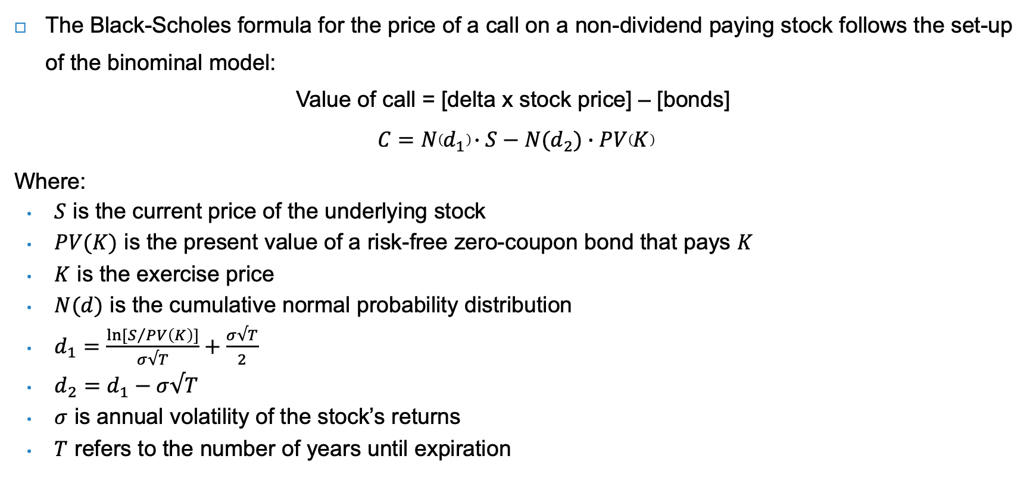
Black-Scholes option pricing model
The Black-Scholes formula for the price of a call on a non-dividend paying stock follows the set-up of the binominal model:
Value of call = [delta x stock price] – [bonds]
$$C=N\left(d_{1}\right)∙S−N(d_{2})∙PV\left(K\right)$$
Where:
$S$ is the current price of the underlying stock
$PV(K)$ is the present value of a risk-free zero-coupon bond that pays $K$
$K$ is the exercise price
$N(d)$ is the cumulative normal probability distribution
$d_{1}=\frac{ln⁡[S/{PV\left(K\right)}]}{σ√T}+\frac{σ√T}{2}$
$d_{2}=d_{1}−σ√T$
$σ$ is annual volatility of the stock’s returns
$T$ refers to the number of years until expiration

Slide 31
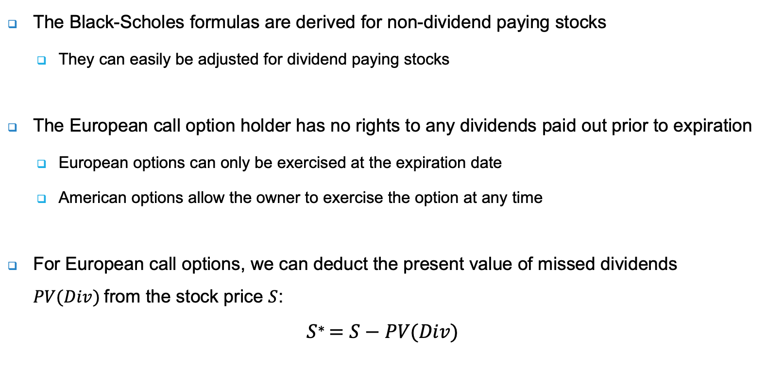
European dividend paying stocks
The Black-Scholes formulas are derived for non-dividend paying stocks
  They can easily be adjusted for dividend paying stocks
The European call option holder has no rights to any dividends paid out prior to expiration
  European options can only be exercised at the expiration date
  American options allow the owner to exercise the option at any time
For European call options, we can deduct the present value of missed dividends $PV(Div)$from the stock price $S$:
$$S^{∗}=S−PV(Div)$$

Slide 32
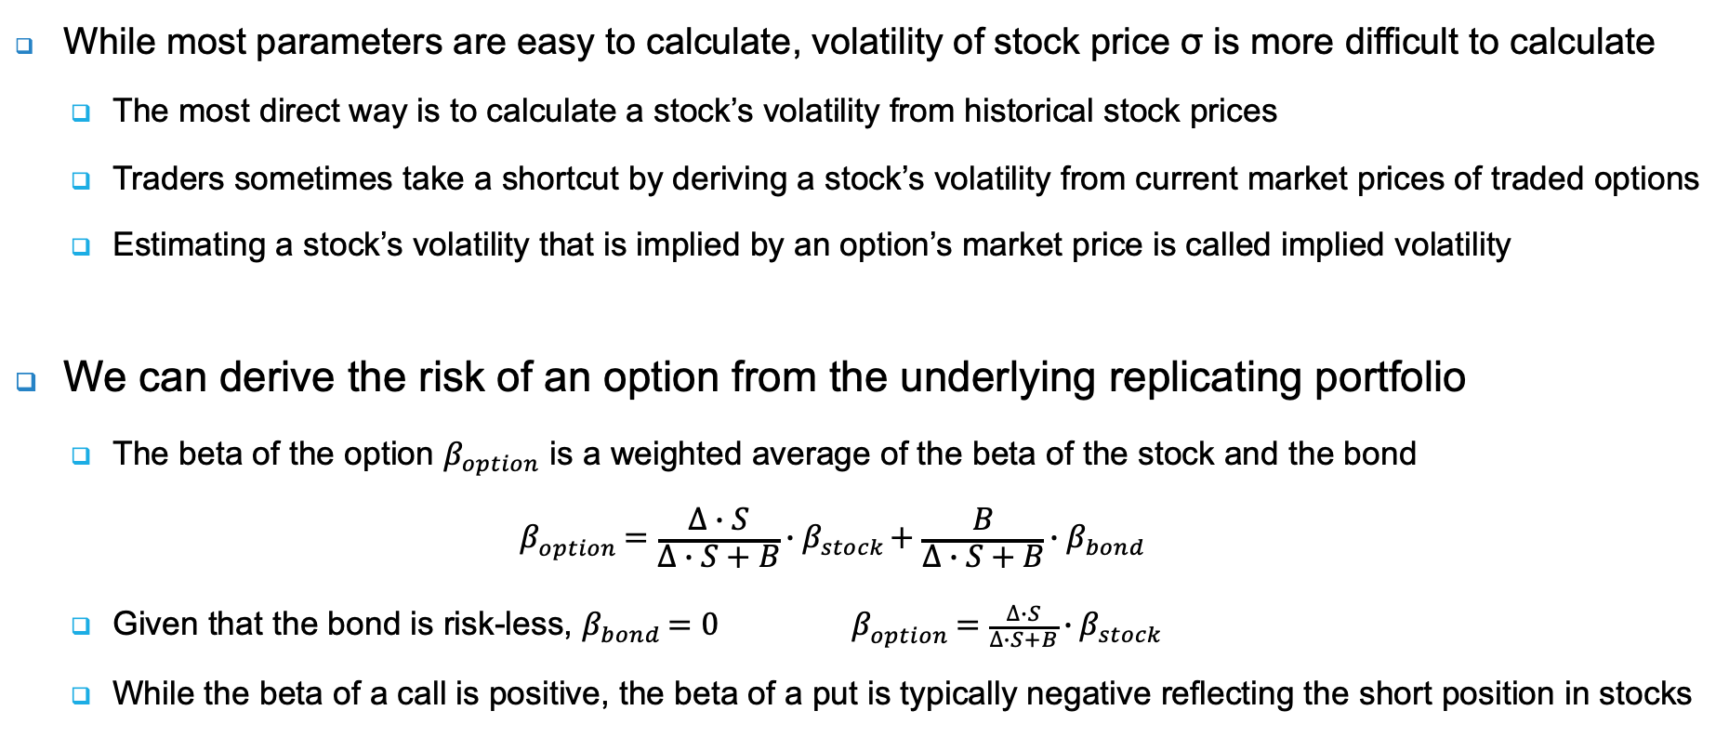
Implied volatility & risk of options
While most parameters are easy to calculate, volatility of stock price σ is more difficult to calculate
  The most direct way is to calculate a stock’s volatility from historical stock prices
  Traders sometimes take a shortcut by deriving a stock’s volatility from current market prices of traded options
  Estimating a stock’s volatility that is implied by an option’s market price is called implied volatility
We can derive the risk of an option from the underlying replicating portfolio
  The beta of the option $β_{option}$ is a weighted average of the beta of the stock and the bond
  $$β_{option}=\frac{∆∙S}{∆∙S+B}∙β_{stock}+\frac{B}{∆∙S+B}∙β_{bond}$$
  Given that the bond is risk-less, $β_{bond}=0$ $β_{option}=\frac{∆∙S}{∆∙S+B}∙β_{stock}$
  While the beta of a call is positive, the beta of a put is typically negative reflecting the short position in stocks

Slide 33
Drivers of option prices
The Black-Scholes formulas reveal the drivers of option prices
Drivers have different signs for calls and puts (see table)
Option price
Time to expire
Risk-free interest rate
Strike price
Underlying value
Volatility
Driver | Call option | Put option
Underlying value | + | -
Volatility | + | +
Strike price | - | +
Time to expiration | + | +
Risk-free interest rate | + | -

Slide 34
Real options
A real option is the opportunity to make a particular business decision gives flexibility
In contrast to financial options:
  They are not exchange traded
  There is no formal option contract
  There is no clear counterparty
Similar to financial options, real options have a payoff that depends on factors such as the underlying value and a strike price on that underlying value
  Being long in real options provides valuable flexibility to exercise an opportunity
  Being short in real options can be very risky and value destructive
You typically cannot price real options by no-arbitrage principles since these real options are not redundant
  This means you cannot make a replicating portfolio to price real options

Slide 35
Application of real options
Many corporate assets, particularly growth opportunities, can be viewed as call options (Myers, 1977)
Such ‘real options’ depends on discretionary future investment by the firm
Example: a company has developed an innovative technology
  The company now has a put option on the production costs of the innovative technology
  The strike price is the production cost of the traditional technology
  When costs of the innovative technology go down, the put option comes ‘in-the-money’
Luehrman (1998): “In financial terms, a business strategy is much more like a series of options than a series of static cash flows”

Slide 36
Types of real options
Koller, Goedhart and Wessels (2020) provide a classification of real options:
  Option to defer (a call): flexibility to wait and do the same action later
  Abandonment option (put): option to stop an operation
  Follow-on (compound) option: a series of options on options
  Option to expand (call) or contract (put): flexibility in the size of the operations
  Option to extend (call) or shorten (put): flexibility to adapt the lifetime of an operation
  Option to increase scope (call): flexibility to add other operations
  Switching options: flexibility to choose between different operations

Slide 37
Drivers of real options
Drivers of real options follow from the drivers of financial options
  Key point: uncertainty - measured as volatility of cash flows - enhances the flexibility value
Enhances flexibility value
Time to expire
Risk-free interest rate
Investment costs
Lost cash flows
Uncertainty (volatility) about CF
Underlying cash flows alternative
Cash flows existing business
Source: Adapted from Koller, Goodhart and Wessels (2020)

Slide 38
Decision tree analysis for real options
Real options can be analysed using decision trees, which are a graphical representation of future decisions under uncertainty
Example: investing in a mine
The investment at t = 0 effectively buys the company an exposure to metal prices
Once the mine has been built at t = 0, the investment in the mine is not a call anymore at t = 1
The call lies before that at t = 0: the choice to build the mine or not
t = 0
t = 1
t = 2
Metal prices rise
(50% chance)
$5500 million
Invest in a mine
-$2500 million
Metal prices fall
(50% chance)
$800
million
Don’t invest in a mine
$0

Slide 39
Decision tree analysis for real options
t = 0
t = 1
t = 2
Metal prices rise
(50% chance)
$5500 million
Invest in a mine
-$2500 million
Metal prices fall
(50% chance)
$800
million
Conclusion: the expected payoff is positive, so the company should invest in the mine
Don’t invest in a mine
$0
Scenario | Payoff (1) | Probability (2) | Expected payoff (3) | Previous payoff (4) | Total payoff (5) | Total expected payoff (6)
Calculation |  |  | (1)*(2) |  | (1)+(4) | (5)*(2)
Metal prices rise | 5,500 | 50% | 2,750 | -2,500 | 3,000 | 1,500
Metal prices fall | 800 | 50% | 400 | -2,500 | -1,700 | -850
Total |  | 100% | 3,150 |  |  | 650

Slide 40
Corporate use of real options
In corporate practice, the use of real options is not as widespread as academics had imagined
  Managers tend to favour DCF analysis in capex decisions, or simpler but flawed alternatives, such as the payback criterion
Triantis and Borison (2001) identify three main corporate uses of real options:
  As a strategic way of thinking
  As an analytical valuation tool
  As an organisation-wide process for evaluating, monitoring, and managing capital investments
Often, managers are not aware of the options they have, since these options are not explicitly presented as such (‘opaque framing’) and are thus not identified in the first place

Slide 41
Real call positions driven by E and S
How to think about real call options driven by E and S?
  On the long side, calls result from grasping E and S opportunities
  On the short side are incumbent companies that are currently destroying value on E or S
The intrinsic value of the long call increases with the size of the positive externality (opportunity)
The value of the short call decreases with the size of the negative externality (incumbent technology)
The intrinsic value of the real call option increases with the attractiveness of the new technology and decreases with the attractiveness of the incumbent technology
As the new technology becomes competitive, the value of the long call goes up and might come in-the-money, while that of the short call falls

Slide 42
E and S drivers of real call options on F
 |  | Long call | Short call
Underlying value | Size of the positive externality of the new technology relative to the old technology CFs new technology | + + | - -
Strike price | CFs incumbent technology | - | +
Volatility | Transition tensions | + | -
Time to expiration | Economic life of the incumbent technology | + | -
Risk-free interest rate | PV of the incumbent technology (strike price) | + | -

Slide 43
Example of DSM’s product Bovaer
DSM has developed the product Bovaer, which reduces methane emissions of cows
  The development cost of Bovaer is the option premium at €4 per unit product
  The strike price of the call is the production cost of Bovaer at €5 per unit product
Note: these numbers are fictional and intended for illustrative purposes
DSM will start producing and selling Bovaer
(i.e. exercising the call option) as soon as the
methane tax exceeds the strike price
  DSM will break even at a methane tax of €9
From a short call perspective: as the transition tensions and/or size of externality increases (i.e. the methane tax rises), the risk of doing nothing increases
  This should push companies to consider strategies that avoid this risk by phasing out old technologies

Slide 44
Real put positions driven by E and S
Practical example of a short put: Boeing taking short-curs in safety
  Every year Boeing benefits from cost reductions (put premium)
  Until one year this led to an accident and massive costs
The underlying value is the safety level of the aircraft: the probability that no accidents happen which will result in large fines
Safe transport and arrival of
passengers is the threshold and
strike price: below that price,
costs rise significantly
 |  | Long put | Short put
Underlying value | Safety level as measured by: - Health of passengers - Avoiding multi-billion dollar fines | - - | + +
Strike price | Passengers arrive safely due to safety investment | + | -
Volatility | Swings in resulting safety levels | + | -
Time to expiration | Use time of the planes produced | + | -
Risk-free interest rate | PV of the safety investment | - | +

Slide 45
Comparing call and put examples
There are at least three differences between the put and call examples
  The put examples are not a transition risk: it is not a bigger societal challenge, but purely the result of decisions to economise on safety
  The short puts are not driven directly by competing products: there is no new technology that can eradicate the negative externality
  There is no clear counterparty that has the exact mirror position
There are also similarities:
  Both long calls and short puts have a competitive element:
    Companies that invest in long calls increase their competitive composition by frontloading new technology
    Companies that write short puts increase their competitive position by cutting costs

Slide 46
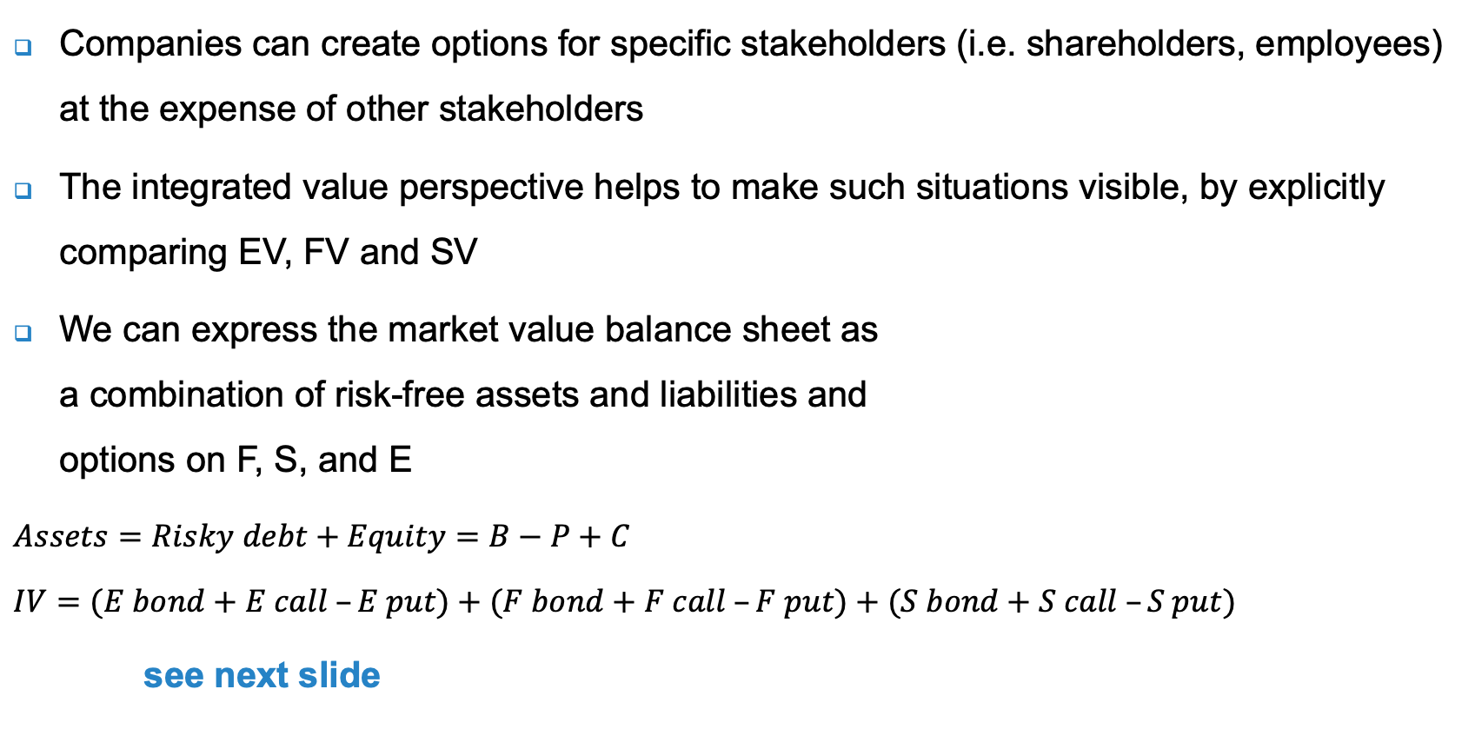
Integrated value as a set of real options
Companies can create options for specific stakeholders (i.e. shareholders, employees) at the expense of other stakeholders
The integrated value perspective helps to make such situations visible, by explicitly comparing EV, FV and SV
We can express the market value balance sheet as
a combination of risk-free assets and liabilities and
options on F, S, and E
$$Assets=Risky debt+Equity=B−P+C$$
$$IV=(E bond+E call –E put)+(F bond+F call –F put)+(S bond+S call –S put)$$
see next slide
S assets | 20 |  |  | S debt | 5
 |  |  |  | S equity | 15
E assets | 15 |  |  | E debt | 25
 |  |  |  | E equity | -10
F assets | 25 |  |  | F debt | 5
 |  |  |  | F equity | 20
Total integrated assets | 60 |  |  | Total integrated liabilities | 60

Slide 47
IV balance sheet
EV = | E bond | + call on E | - put on E
example: | + : natural capital improvements realised - : natural capital destruction caused | still to be realised emission savings | biodiversity damage resulting from activities
+
FV = | F bond | + call on F | - put on F
example: | CF from business as usual | potential additional CF from current / new projects / products | potential reductions in CF from current / new projects / products
+
SV = | S bond | + call on S | - put on S
example: | + : health improvements realised - : health reductions caused | still to be realised health improvements | still to be experienced health reductions from, for example, savings on safety
=
IV = | I bond | + call on I | - put on I

Slide 48
Conclusions
Financial options are contracts that give the owner the right to buy or sell a security at a pre-specified price
The seller or writer, who is short the option, has the opposite position of the buyer, and has to exercise the contract if the buyer wants to do so
A real option is the opportunity to make a particular business decision, exemplifying the value of flexibility
One can visualise both financial options and real options with decision trees and payoff graphs
Real options on F can have E or S drivers: payoff in terms of F, but with E or S as the underlying values
Companies have a lot of put options against society, but awareness of it is low: this calls for an integrated view on options or integrated value expressed in real options

