Slide 1
Corporate Finance for Long-Term Value
Chapter 15: Capital structure

Slide 2
Chapter 15: Capital structure
Part 5: Corporate financial policies

Slide 3
The BIG Picture
How should companies decide on their capital structure?
Capital structure is the funding mix of equity and debt
Discussion
In a perfect capital market
capital structure is irrelevant for company value, and
the cost of equity increases with leverage (debt financing)
In a world with imperfections, like corporate taxes, bankruptcy cost and information asymmetries, capital structure matters to financial value
Companies generate also asset and liabilities on E and S
The integrated capital structure (F, S and E) is an indicator of a company’s overall risk profile

Slide 4
Financial capital structure
Financial capital structure is about the funding of the company’s business activities
It refers to the company’s distribution of equity, debt and hybrid securities, referred to as leverage:
$$Leverage=\frac{Debt}{Value}=\frac{Debt}{Total assets}$$
Companies with a high proportion of debt on their balance sheet are highly levered / leveraged

Slide 5
Financial capital structure
Leverage is measured by ratios that express:
The distribution of the types of securities – debt-equity ratio or debt-assets ratio
The ability to bear the interest burden – interest coverage ratio
Debt-equity ratio = 5 / 20 = 0.25
Debt-assets ratio = 5 / 25 = 0.20
F assets | 25 |  | F debt | 5
 |  |  | F equity | 20
Total F assets | 25 |  | Total F liabilities | 25

Slide 6
Theories on perfect capital markets
Modigliani and Miller (1958): corporate finance in the real world is a complex topic
Arbitrage argument: due to buying and selling a company’s shares with borrowed funds, price differences on leverage should disappear
Two MM propositions:
MM1: In a perfect capital market, the value of the levered company V_{L} equals the value of the unlevered company V_{U}
MM2: The cost of capital of levered equity increases with the company’s debt-equity ratio (based on market values of debt and equity)

Slide 7
Theories on perfect capital markets
MM1: In a perfect capital market, the value of the levered company V_{L} equals the value of the unlevered company V_{U}
$$V_{U}=V_{L}$$
$V_{U}=\frac{{FCF}_{U}}{r_{U}}$ $V_{L}=\frac{{FCF}_{equity}}{r_{equity}}+\frac{{FCF}_{debt}}{r_{debt}}$
MM2: The cost of capital of levered equity increases with the company’s market value debt-equity ratio
$$r_{equity}=r_{U}+\frac{debt}{equity}∗\left(r_{U}−r_{debt}\right)$$
which follows from: $\text{wacc}=r_{U}=\frac{equity}{V_{L}}∗r_{equity}+\frac{debt}{V_{L}}∗r_{debt}$

Slide 8
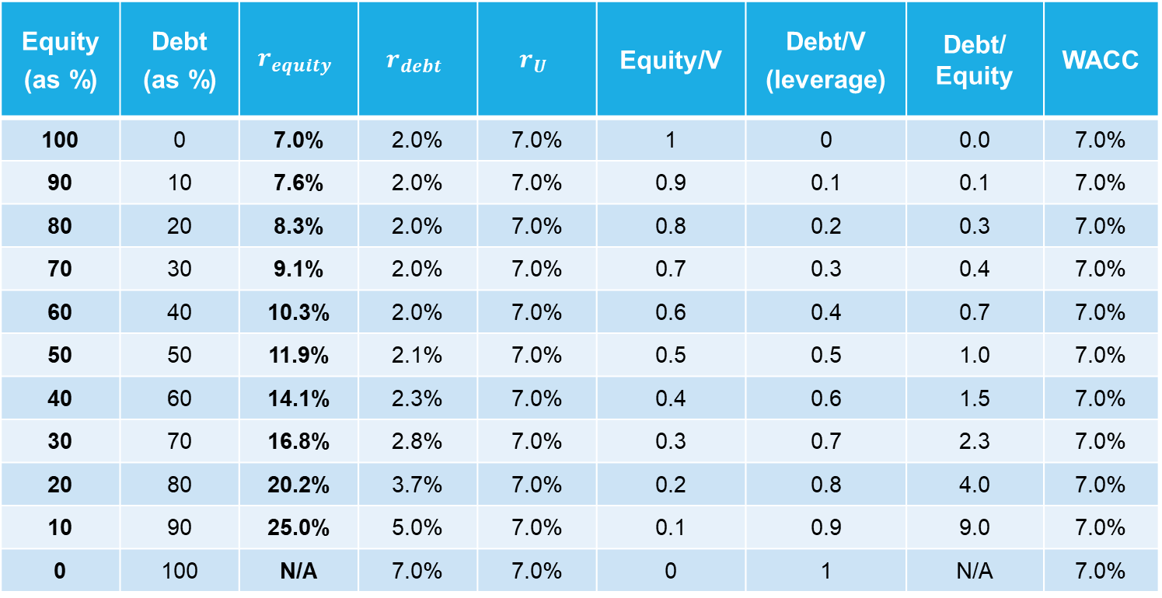
Cost of equity with rising leverage
Equity (as %) | Debt (as %) | $$r_{equity}$$ | $$r_{debt}$$ | $$r_{U}$$ | Equity/V | Debt/V (leverage) | Debt/ Equity | WACC
100 | 0 | 7.0% | 2.0% | 7.0% | 1 | 0 | 0.0 | 7.0%
90 | 10 | 7.6% | 2.0% | 7.0% | 0.9 | 0.1 | 0.1 | 7.0%
80 | 20 | 8.3% | 2.0% | 7.0% | 0.8 | 0.2 | 0.3 | 7.0%
70 | 30 | 9.1% | 2.0% | 7.0% | 0.7 | 0.3 | 0.4 | 7.0%
60 | 40 | 10.3% | 2.0% | 7.0% | 0.6 | 0.4 | 0.7 | 7.0%
50 | 50 | 11.9% | 2.1% | 7.0% | 0.5 | 0.5 | 1.0 | 7.0%
40 | 60 | 14.1% | 2.3% | 7.0% | 0.4 | 0.6 | 1.5 | 7.0%
30 | 70 | 16.8% | 2.8% | 7.0% | 0.3 | 0.7 | 2.3 | 7.0%
20 | 80 | 20.2% | 3.7% | 7.0% | 0.2 | 0.8 | 4.0 | 7.0%
10 | 90 | 25.0% | 5.0% | 7.0% | 0.1 | 0.9 | 9.0 | 7.0%
0 | 100 | N/A | 7.0% | 7.0% | 0 | 1 | N/A | 7.0%

Slide 9
Cost of equity with rising leverage

Slide 10
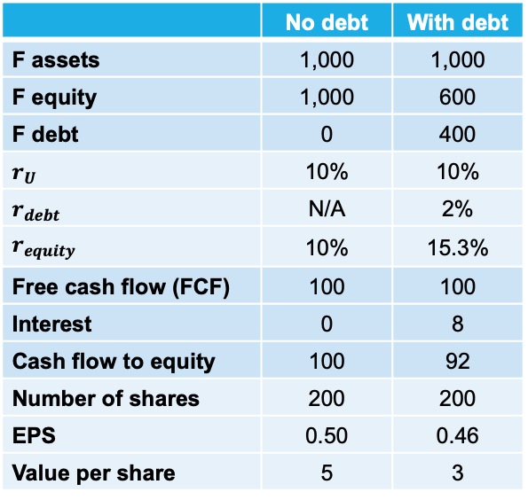
Impact of debt issuance
A change in capital structure does not mean a change in value (MM1), while it does mean a change in the cost of equity capital (MM2)
Company without leverage
 | No debt | With debt
F assets | 1,000 | 1,000
F equity | 1,000 | 600
F debt | 0 | 400
$r_{U}$ | 10% | 10%
$r_{debt}$ | N/A | 2%
$r_{equity}$ | 10% | 15.3%
Free cash flow (FCF) | 100 | 100
Interest | 0 | 8
Cash flow to equity | 100 | 92
Number of shares | 200 | 200
EPS | 0.50 | 0.46
Value per share | 5 | 3
No change in value
F assets | 1,000 |  | F debt | 1,000
Total F assets | 1,000 |  | Total F liabilities | 1,000
Change in cost of equity capital
Company with leverage
F assets | 1,000 |  | F debt | 400
 |  |  | F equity | 600
Total F assets | 1,000 |  | Total F liabilities | 1,000

Slide 11
Financial capital structure with imperfections
MM1 shows the conservation of value principle: in perfect capital markets, financial transactions do not add or destroy financial value (FV)
Market imperfections that matter for financial capital structure include:
Corporate taxes $τ_{c}$ and bankruptcy costs (static trade-off theory)
Information asymmetries (pecking order theory)

Slide 12
Static trade-off theory
In perfect capital markets, companies can go bankrupt at zero cost, while in the real world, such losses do occur
Managers recognise the offsetting effects of tax benefits and bankruptcy costs
This suggests that there is an optimal point whereby overall cost of capital (WACC) is minimalised

Slide 13
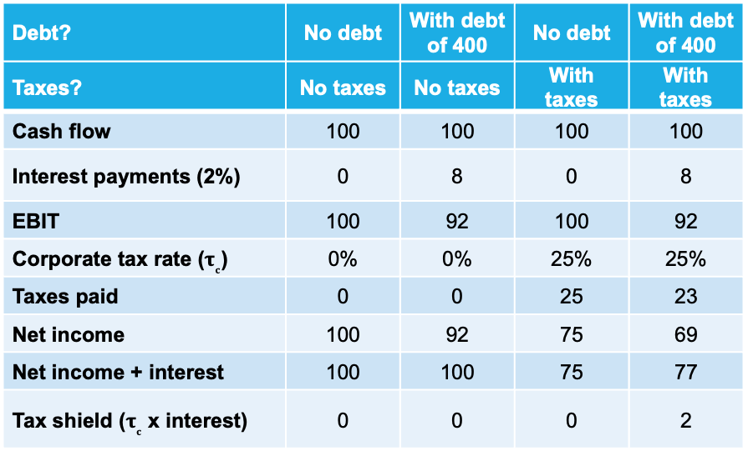
Interest tax shield
Tax benefits are also known as the interest tax shield
$$Tax shield=τ_{c}∗interest payments=τ_{c}∗r_{debt}∗debt$$
$$\text{After}\text{−}\text{tax} WACC=\frac{equity}{V_{L}}∗r_{equity}+\frac{debt}{V_{L}}∗r_{debt}∗(1−τ_{c})$$
MM1 (with taxes): $$V_{U}=V_{L}+τ_{c}∗debt$$
MM2 (with taxes): $r_{equity}=r_{U}+\frac{debt}{equity}∗\left(r_{U}−r_{debt}\right)(1−τ_{c})$
Debt? | No debt | With debt of 400 | No debt | With debt of 400
Taxes? | No taxes | No taxes | With taxes | With taxes
Cash flow | 100 | 100 | 100 | 100
Interest payments (2%) | 0 | 8 | 0 | 8
EBIT | 100 | 92 | 100 | 92
Corporate tax rate ($τ_{c}$) | 0% | 0% | 25% | 25%
Taxes paid | 0 | 0 | 25 | 23
Net income | 100 | 92 | 75 | 69
Net income + interest | 100 | 100 | 75 | 77
Tax shield ($τ_{c}$ x interest) | 0 | 0 | 0 | 2

Slide 14
Bankruptcy costs
As a company’s leverage increases, the chance also rises that it cannot meet its debt obligations
A company is in distress when it’s close to being unable to meet debt obligations
In a perfect capital market, there are no costs to reorganising the company, but in the real world, there are direct and indirect costs of bankruptcy
Direct costs include fees paid to administrators, accountants, investment bankers, lawyers and courts
Indirect costs include the value loss of missed sales and investments

Slide 15
Static trade-off theory
Taxes and bankruptcy costs have opposite implications for capital structure:
Taxes give incentives for higher leverage
Bankruptcy costs incentivise managers to reduce leverage
The optimal capital structure:
Overall cost of capital is minimalised
A sizeable tax benefit is obtained
Without excessive bankruptcy costs
Trade-off theory predicts that companies’ debt ratios move towards a target capital structure, which is determined by the balance of tax benefits and bankruptcy/distress costs

Slide 16
Agency costs
Agency costs result from the principal-agent conflict, which regards:
Tensions between owners/financiers (the principals) and management (the agents)
Tensions among financiers (debtholders vs shareholders)
Information asymmetry: managers know much better what is happening at the company than its financiers
Higher information asymmetry leads to higher cost of capital
Information asymmetries are largest for equity issues

Slide 17
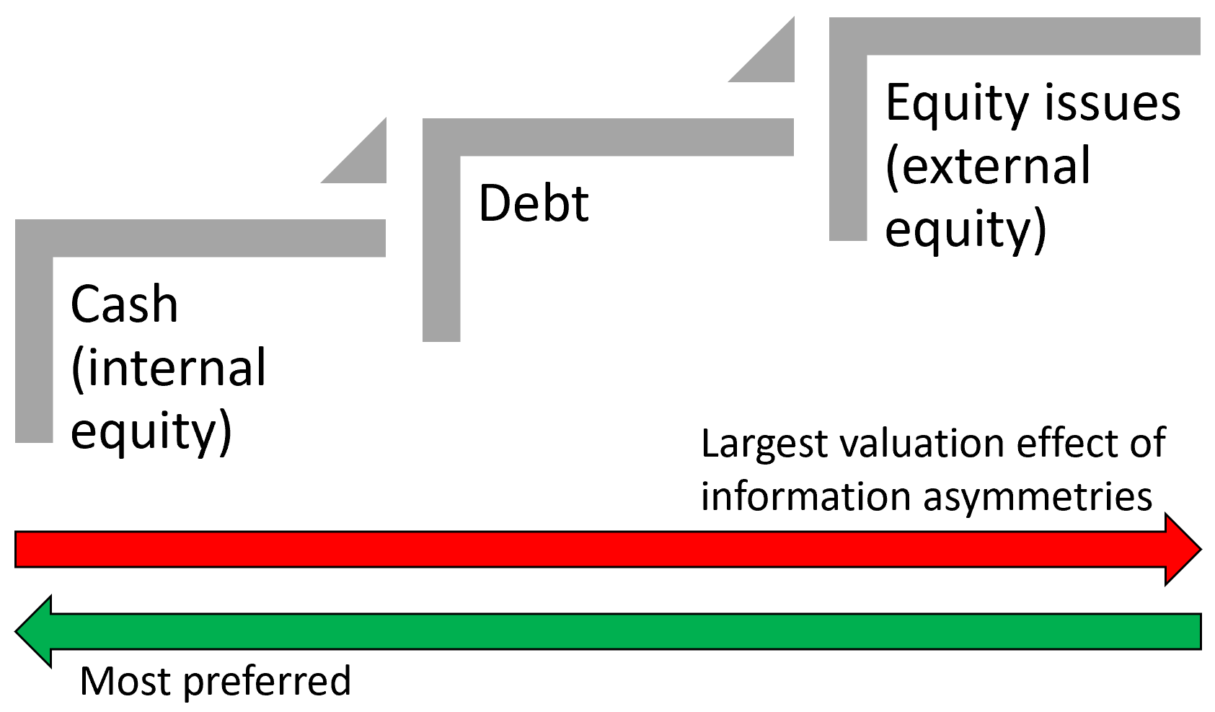
Pecking order theory
Managers prefer:
Internal finance (from cash flows and retained earnings)
External debt
External equity

Slide 18
Behavioural issues in capital structure
Corporate financial policies such as capital structure choices are also driven by behavioural issues:
Those of managers themselves – internal errors
Optimistic managers use leverage more aggressively, overestimate cash flows and the interest levels they can afford to pay
Optimistic managers tend to think their company’s stock is undervalued
Optimistic managers are likely to choose higher debt levels than rational managers
Those of the markets they operate in – external errors
(Temporarily) irrational markets can result in the absence of funding opportunities for positive NPV projects

Slide 19
E and S affecting capital structure
E and S risks can affect:
The business model and operations - which affect interest coverage ratios and project NPVs
Investor perceptions – which affect cost of capital, valuation and financial capital structure

Slide 20
E and S affecting the business model of an airline
With internalisation, E and S risk materialises:
Subsidies disappear
Carbon taxes increase costs
Demand for air travel drops
Leads to 30% reduction in NPV (total assets: 30 → 21)
Increased probability of default leads to 10% drop in value of debt
NPV of F assets drops more than debt value, so leverage rises (0.40 → 0.51)
Company before internalisation
F assets | 30 |  | F debt | 12
 |  |  | F equity | 18
Total assets | 30 |  | Total liabilities | 30
Debt-assets ratio: 12 / 30 = 0.40
Company after internalisation
F assets | 21 |  | F debt | 10.8
 |  |  | F equity | 10.2
Total assets | 21 |  | Total liabilities | 21
12 x 0.9 = 10.8
21 – 10.8 = 10.2
Debt-assets ratio: 10.8 / 21 = 0.51

Slide 21
E and S affecting investor perceptions
In anticipation of possible internalisation of E and S, investors may perceive higher financial risk
Leads to lower asset value due to higher discount rate and/or lower expected cash flows
Lower expected cash flows result from investors attaching higher probabilities to more negative scenarios
Higher cost of capital results from higher expected variations in outcomes and sensitivity to market returns

Slide 22
Capital structure of E and S
Expressing externalities on E and S in capital structure ratios helps in identifying and understanding the size of the risks involved
E and S assets indicate value creation by the company for society
E and S liabilities (debt) indicate value destruction by the company at the cost of society
S assets | 20 |  | S debt | 15
 |  |  | S equity | 5
Total assets | 20 |  | Total liabilities | 20
S assets > S debt, so net value creation on S
S leverage ratio: 15 / 20 = 0.75
E assets | 15 |  | E debt | 25
 |  |  | E equity | -10
Total assets | 15 |  | Total liabilities | 15
E assets < E debt, so net value destruction on E
E leverage ratio: 25 / 15 = 1.67

Slide 23
Integrated capital structure
The integrated capital structure is the capital structure of E, S and F combined
Integrated leverage indicates the risk in a company’s integrated capital structure
$$Integrated leverage=\frac{Integrated debt}{Integrated assets}$$
S assets | 20 |  | S debt | 15
 |  |  | S equity | 5
E assets | 15 |  | E debt | 25
 |  |  | E equity | -10
F assets | 25 |  | F debt | 5
 |  |  | F equity | 20
Total integrated assets | 60 |  | Total integrated liabilities | 60
Leverage ratios |  |  | Composition of assets |  |  | Composition of debt
F debt / F assets | 0.20 |  | F assets / I assets | 0.42 |  | F debt / I debt | 0.14
S debt / S assets | 0.25 |  | S assets / I assets | 0.33 |  | S debt / I debt | 0.14
E debt / E assets | 1.67 |  | E assets / I assets | 0.25 |  | E debt / I debt | 0.71
I debt / I assets | 0.58 |  | Total | 1.00 |  | Total | 1.00
Insight: high integrated leverage
Insight: evenly distributed
Insight: E is problematic

Slide 24
Peer group analysis
Packaging company 1 has:
A low E leverage ratio compared to the average mining company
A high E leverage ratio compared to other packaging companies
So the company is at a competitive disadvantage
Mining company 1 has:
A high E leverage ratio compared to the average packaging company
A low E leverage ratio compared to other mining companies
So the company is at a competitive advantage
Peer group 1 | E debt / E assets
Packaging company 1 | 1.67
Packaging company 2 | 1.22
Packaging company 3 | 1.37
Packaging companies average | 1.42
Peer group 2 | E debt / E assets
Mining company 1 | 3.41
Mining company 2 | 7.58
Mining company 3 | 6.19
Mining companies average | 5.73

Slide 25
Inditex
Using Inditex’s value components, the integrated balance sheet can be generated:
Positive SV and EV = assets
Negative SV and EV = debt
Assets – debt = equity
Calculating leverage:
Financial leverage: F debt / F assets = -3 / 79 = -4%
Integrated leverage: I debt / I assets = (-3 + 137 + 183) / 362 = 87%
Insight: Inditex is riskier
IV calculation | Value (€ billions)
FV (company value) | 79
Positive SV | 283
Negative SV | -137
Negative EV | -183
IV (integrated value) | 42
F assets | 79 |  | F debt | -3
 |  |  | F equity | 82
S assets | 283 |  | S debt | 137
 |  |  | S equity | 146
E assets | 0 |  | E debt | 183
 |  |  | E equity | -183
Total integrated assets | 362 |  | Total integrated liabilities | 362
283 – 137 = 146
0 – 183 = -183

Slide 26
Conclusions
The Modigliani-Miller theorems say that in a perfect world:
Financial capital structure is irrelevant for financial value (MM1)
The cost of equity increases with leverage (MM2)
Market imperfections (taxes and bankruptcy costs) explain under what conditions financial capital structure does matter to financial value
E and S risks affect capital structure through changes in the business model and investor perceptions
Companies also generate assets and liabilities on E and S
The integrated balance sheet offers a richer perspective on the company’s assets and liabilities than a balance sheet that is limited to F

