Slide 1
Corporate Finance for
Long-Term Value
Chapter 13: Cost of capital

Slide 2
Chapter 13: Cost of capital
Part 4: Risk, return and impact

Slide 3
The BIG Picture
How to calculate the cost of financial, social and environmental capital?
Methods
A company uses the weighted average cost of capital (WACC) to assess the financial attractiveness of projects
WACC is calculated as a weighted average of the cost of equity and the cost of debt
The next step is to add the cost of social and environmental capital to calculate the cost of integrated capital
S and E liabilities increase the cost of integrated capital (indicating S+E risk), while S+E assets decrease the cost of integrated capital
In a dynamic setting, the interaction between the different types of capital can be derived

Slide 4
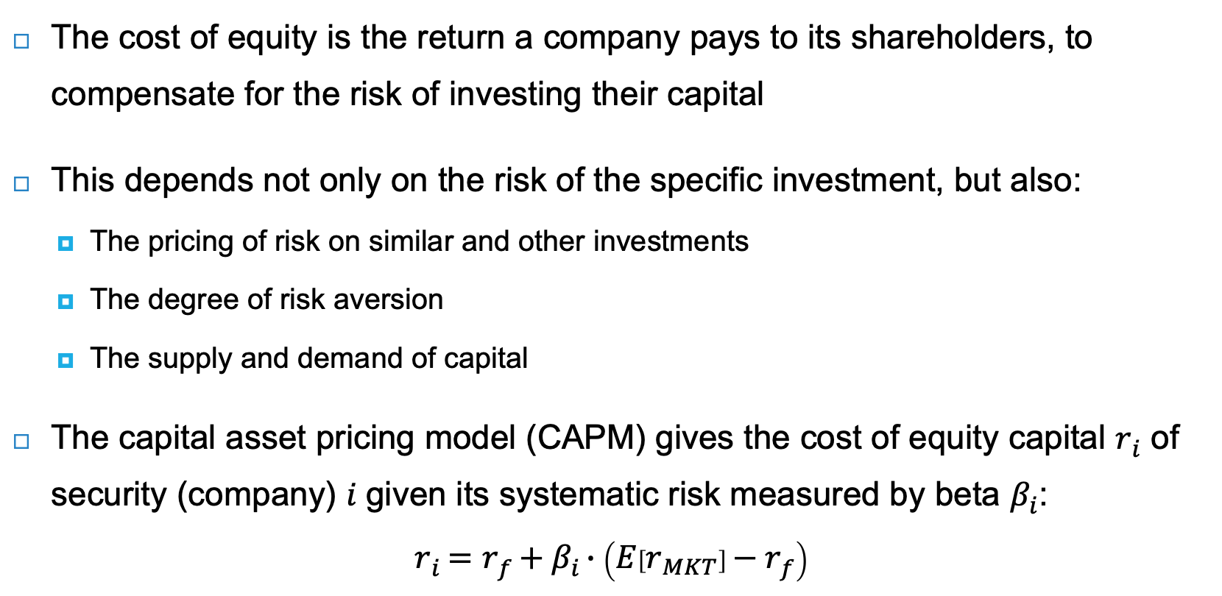
Cost of equity capital
The cost of equity is the return a company pays to its shareholders, to compensate for the risk of investing their capital
This depends not only on the risk of the specific investment, but also:
  The pricing of risk on similar and other investments
  The degree of risk aversion
  The supply and demand of capital
The capital asset pricing model (CAPM) gives the cost of equity capital $r_{i}$ of security (company) 𝑖 given its systematic risk measured by beta $β_{i}$:
$$r_{i}=r_{f}+β_{i}∙\left(E\left[r_{MKT}\right]−r_{f}\right)$$

Slide 5

The security market line
From the cost of equity formula: $r_{i}=r_{f}+β_{i}∙\left(E\left[r_{MKT}\right]−r_{f}\right)$
  The risk premium for security $i$: $β_{i}∙\left(E\left[r_{MKT}\right]−r_{f}\right)$
  The market risk premium: $\left(E\left[r_{MKT}\right]−r_{f}\right)$
Assuming or estimating the parameters above allows us to draw the security market line for security $i$
Difficulties in practice:
What is the market portfolio?
What is the risk-free rate?
What is the beta of a specific security?
What is the horizon of the expected return?
To what extent are historical data representative of the future?

Slide 6

Market risk premium
The market risk premium is defined as the expected market return $E\left[r_{Mkt}\right]$ minus the risk-free rate $r_{f}$
  The risk-free rate is derived from the government yield curve, which provides the safest asset in a country for a given maturity
  The historical risk premium can only be estimated over a long period because markets fluctuate
Historical risk premium (in %). Source: Damodaran (2022)
Market | United States |  | Europe | World
Period | 1928-2021 | 1971-2021 | 1900-2017 | 1900-2017
Risk premium over 1-year government bonds | 6.7% | 6.7% | 3.5% | 4.3%
Risk premium over 10-year government bonds | 5.1% | 4.5% | 3.0% | 3.2%
The observed risk premium has declined over time

Slide 7
Beta
A company’s beta is a measure of the company’s stock price volatility relative to the market’s volatility
  Historical betas can be estimated using linear regression analysis on historical returns against the relevant index (i.e., S&P500, MSCI World Index)
Example: Nike & Adidas
  Betas are often calculated on a 5-year
  monthly basis (60 observations) or a 2-year
  weekly basis (104 observations)
  Measuring shorter frequencies leads to
  higher volatility
Nike & Adidas betas
Monthly beta
 | Nike |  | Adidas
 | vs S&P500 | vs MSCI World | vs DAX30 | vs MSCI World
2-year | 0.80 | 0.80 | 0.81 | 0.94
5-year | 0.92 | 0.92 | 0.69 | 0.81
10-year | 0.77 | 0.73 | 0.72 | 0.77
Average | 0.83 | 0.82 | 0.74 | 0.84
Weekly beta
 | Nike |  | Adidas
 | vs S&P500 | vs MSCI World | vs DAX30 | vs MSCI World
2-year | 1.16 | 1.20 | 1.22 | 1.17
5-year | 1.05 | 1.12 | 1.07 | 1.00
10-year | 1.01 | 1.00 | 0.94 | 1.02
Average | 1.07 | 1.11 | 1.08 | 1.06

Slide 8
Estimating beta for private companies
Suppose a Norwegian salmon harvesting company will soon do an IPO
The company’s beta can be measured by considering the betas of other Norwegian salmon harvesters
How to aggregate observations?
  Average or Median?
  Outliers? Norway Royal Salmon has a 5-year
  monthly beta of 0.00
  Excluding Royal, the average 5-year monthly
  beta (0.54) is close to the median (0.55)
Industry betas for Norwegian salmon harvesting
vs MSCI World | 5-year monthly beta | 2-year weekly beta | Average beta
Bakkafrost | 0.41 | 0.48 | 0.45
SalMar | 0.31 | 0.21 | 0.26
Mowi | 0.70 | 0.46 | 0.58
Leroy Seafood | 0.55 | 0.58 | 0.57
Austevoll Seafood | 0.64 | 0.59 | 0.62
Grieg Seafood | 0.62 | 0.74 | 0.68
Norway Royal Salmon | 0.00 | 0.34 | 0.17
Average | 0.46 | 0.48 | 0.47
Median | 0.55 | 0.48 | 0.57
Average (without Royal) | 0.54 | 0.51 | 0.52

Slide 9

Calculating the cost of equity capital
Problem
Suppose the risk-free rate is 2% and the market risk premium is 4%. What is the cost of equity capital $r_{i}$ for a Norwegian salmon farmer?
Industry betas for Norwegian salmon harvesting
vs MSCI World | 5-year monthly beta | 2-year weekly beta | Average beta
Bakkafrost | 0.41 | 0.48 | 0.45
SalMar | 0.31 | 0.21 | 0.26
Mowi | 0.70 | 0.46 | 0.58
Leroy Seafood | 0.55 | 0.58 | 0.57
Austevoll Seafood | 0.64 | 0.59 | 0.62
Grieg Seafood | 0.62 | 0.74 | 0.68
Norway Royal Salmon | 0.00 | 0.34 | 0.17
Average | 0.46 | 0.48 | 0.47
Median | 0.55 | 0.48 | 0.57
Average (without Royal) | 0.54 | 0.51 | 0.52

Slide 10
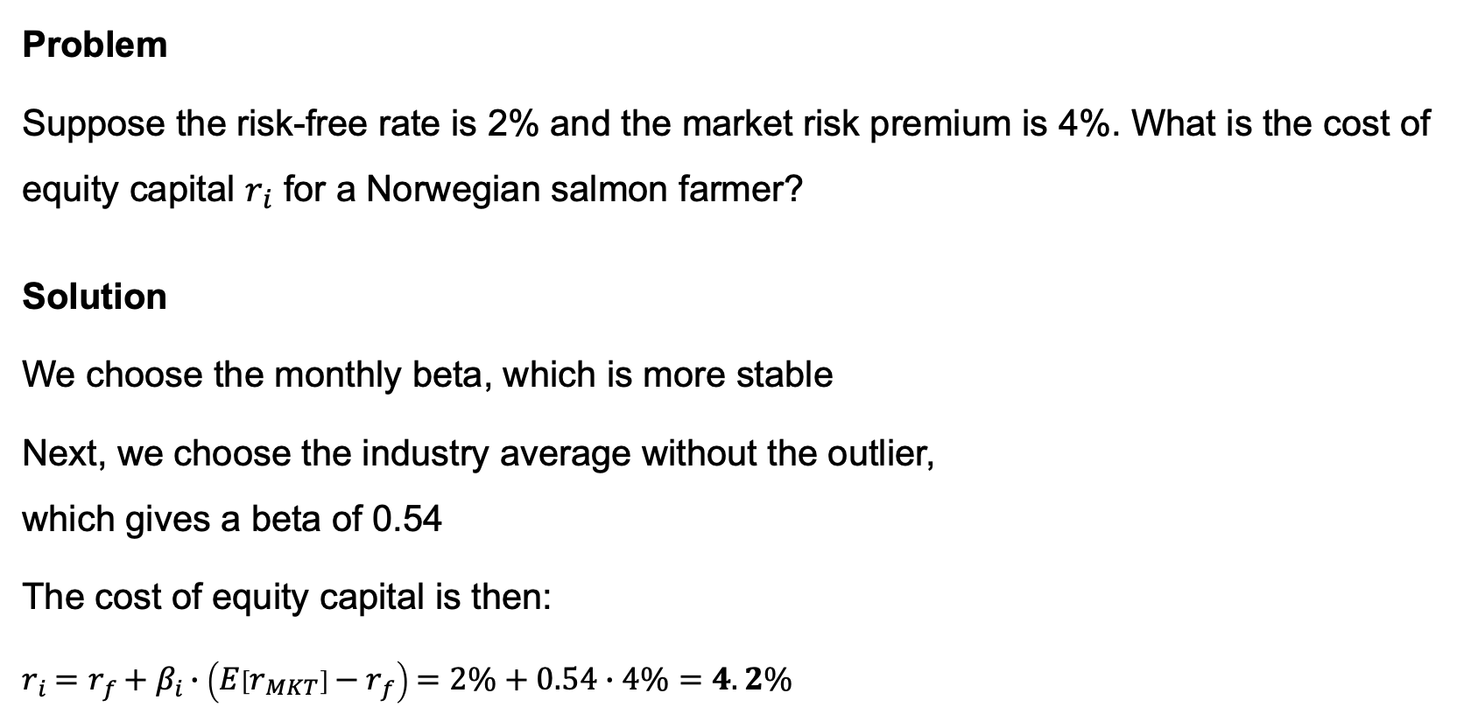
Calculating the cost of equity capital
Problem
Suppose the risk-free rate is 2% and the market risk premium is 4%. What is the cost of equity capital $r_{i}$ for a Norwegian salmon farmer?
Solution
We choose the monthly beta, which is more stable
Next, we choose the industry average without the outlier,
which gives a beta of 0.54
The cost of equity capital is then:
$r_{i}=r_{f}+β_{i}∙\left(E\left[r_{MKT}\right]−r_{f}\right)=2\%+0.54∙4\%=4.2\%$
Industry betas for Norwegian salmon harvesting
vs MSCI World | 5-year monthly beta | 2-year weekly beta | Average beta
Bakkafrost | 0.41 | 0.48 | 0.45
SalMar | 0.31 | 0.21 | 0.26
Mowi | 0.70 | 0.46 | 0.58
Leroy Seafood | 0.55 | 0.58 | 0.57
Austevoll Seafood | 0.64 | 0.59 | 0.62
Grieg Seafood | 0.62 | 0.74 | 0.68
Norway Royal Salmon | 0.00 | 0.34 | 0.17
Average | 0.46 | 0.48 | 0.47
Median | 0.55 | 0.48 | 0.57
Average (without Royal) | 0.54 | 0.51 | 0.52

Slide 11
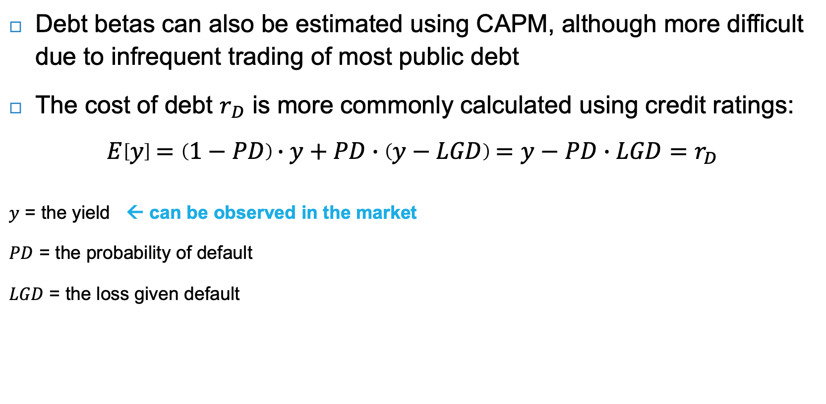
Cost of debt capital
Debt betas can also be estimated using CAPM, although more difficult due to infrequent trading of most public debt
The cost of debt $r_{D}$ is more commonly calculated using credit ratings:
$$E\left[y\right]=\left(1−PD\right)∙y+PD∙\left(y−LGD\right)=y−PD∙LGD=r_{D}$$
$y$ = the yield ← can be observed in the market
$PD$ = the probability of default
$LGD$ = the loss given default
Rating agency | Moody’s | S&P’s and Fitch | Long-term average default rate | Debt betas
Type of bonds | Investment grade bonds
 | Aaa | AAA | 0.00% | <0.05
 | Aa | AA | 0.02%
 | A | A | 0.05%
 | Baa | BBB | 0.16% | 0.10
Type of bonds | Junk or high yield bonds
 | Ba | BB | 0.61% | 0.17
 | B | B | 3.33% | 0.26
 | Caa | CCC | 27.08% | 0.31
 | Ca | CC |  | -
 | C | C |  | -
← require estimates
Source: S&P Global Ratings (2020a) & Berk and DeMarzo (2020)

Slide 12

Calculating the cost of debt capital
Problem
The Norwegian salmon farmer, SalMar, has a rating of BBB and a yield of 3.22% in June 2022. The loss given default is 60%. What is SalMar’s cost of debt capital $r_{D}$?
Rating agency | Moody’s | S&P’s and Fitch | Long-term average default rate | Debt betas
Type of bonds | Investment grade bonds
 | Aaa | AAA | 0.00% | <0.05
 | Aa | AA | 0.02%
 | A | A | 0.05%
 | Baa | BBB | 0.16% | 0.10
Type of bonds | Junk or high yield bonds
 | Ba | BB | 0.61% | 0.17
 | B | B | 3.33% | 0.26
 | Caa | CCC | 27.08% | 0.31
 | Ca | CC |  | -
 | C | C |  | -
Source: S&P Global Ratings (2020a) & Berk and DeMarzo (2020)

Slide 13
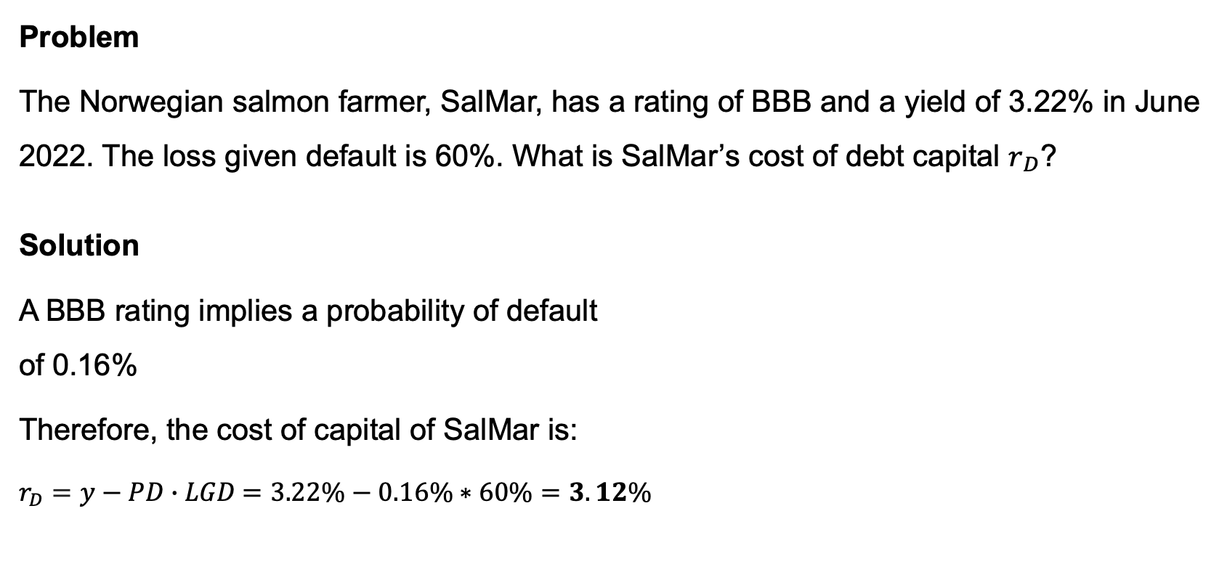
Calculating the cost of debt capital
Problem
The Norwegian salmon farmer, SalMar, has a rating of BBB and a yield of 3.22% in June 2022. The loss given default is 60%. What is SalMar’s cost of debt capital $r_{D}$?
Solution
A BBB rating implies a probability of default
of 0.16%
Therefore, the cost of capital of SalMar is:
$r_{D}=y−PD∙LGD$ $=3.22\%−0.16\%∗60\%=3.12\%$
Rating agency | Moody’s | S&P’s and Fitch | Long-term average default rate | Debt betas
Type of bonds | Investment grade bonds
 | Aaa | AAA | 0.00% | <0.05
 | Aa | AA | 0.02%
 | A | A | 0.05%
 | Baa | BBB | 0.16% | 0.10
Type of bonds | Junk or high yield bonds
 | Ba | BB | 0.61% | 0.17
 | B | B | 3.33% | 0.26
 | Caa | CCC | 27.08% | 0.31
 | Ca | CC |  | -
 | C | C |  | -
Source: S&P Global Ratings (2020a) & Berk and DeMarzo (2020)

Slide 14
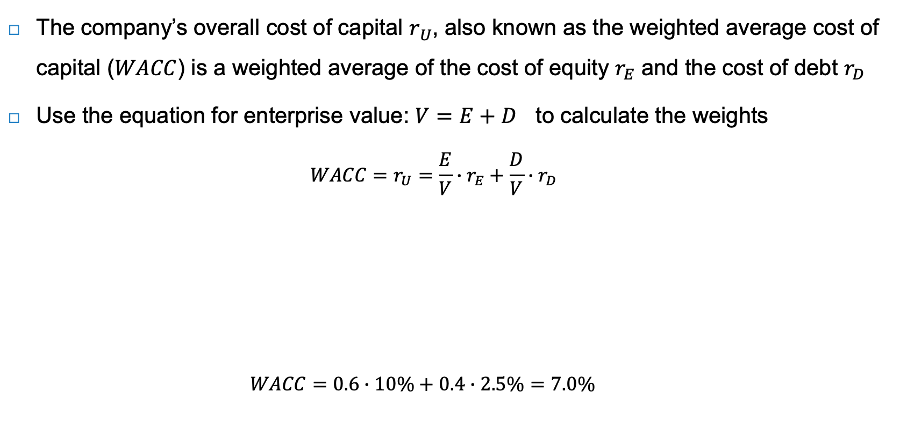
Weighted average cost of capital (WACC)
The company’s overall cost of capital $r_{U}$, also known as the weighted average cost of capital ($WACC$) is a weighted average of the cost of equity $r_{E}$ and the cost of debt $r_{D}$
Use the equation for enterprise value: $V=E+D$ to calculate the weights
  $$WACC=r_{U}=\frac{E}{V}∙r_{E}+\frac{D}{V}∙r_{D}$$
  $WACC=0.6∙10\%+0.4∙2.5\%=7.0\%$
 | Value | Discounted at |  | Value | Discounted at
Assets | 100 | ?% | Debt | D = 40 | 2.5%
 |  |  | Equity | E = 60 | 10%
Enterprise value | V = 100 | ?% | Enterprise value | V = 100 | ?%

Slide 15
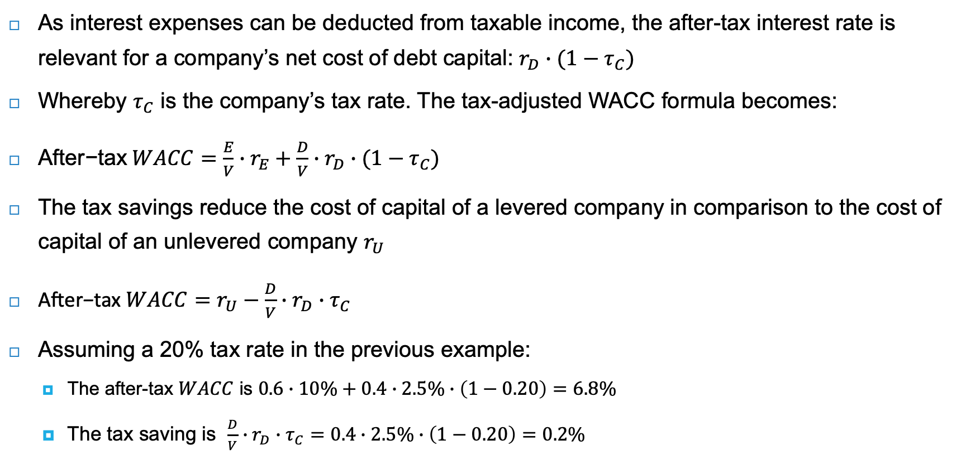
After-tax WACC
As interest expenses can be deducted from taxable income, the after-tax interest rate is relevant for a company’s net cost of debt capital: $r_{D}∙(1−τ_{C})$
Whereby $τ_{C}$ is the company’s tax rate. The tax-adjusted WACC formula becomes:
$\text{After}\text{−}\text{tax} WACC=\frac{E}{V}∙r_{E}+\frac{D}{V}∙r_{D}∙(1−τ_{C})$
The tax savings reduce the cost of capital of a levered company in comparison to the cost of capital of an unlevered company $r_{U}$
$\text{After}\text{−}\text{tax} WACC=r_{U}−\frac{D}{V}∙r_{D}∙τ_{C}$
Assuming a 20% tax rate in the previous example:
  The after-tax $WACC$ is $0.6∙10\%+0.4∙2.5\%∙\left(1−0.20\right)=6.8\%$
  The tax saving is $\frac{D}{V}∙r_{D}∙τ_{C}=0.4∙2.5\%∙\left(1−0.20\right)=0.2\%$

Slide 16
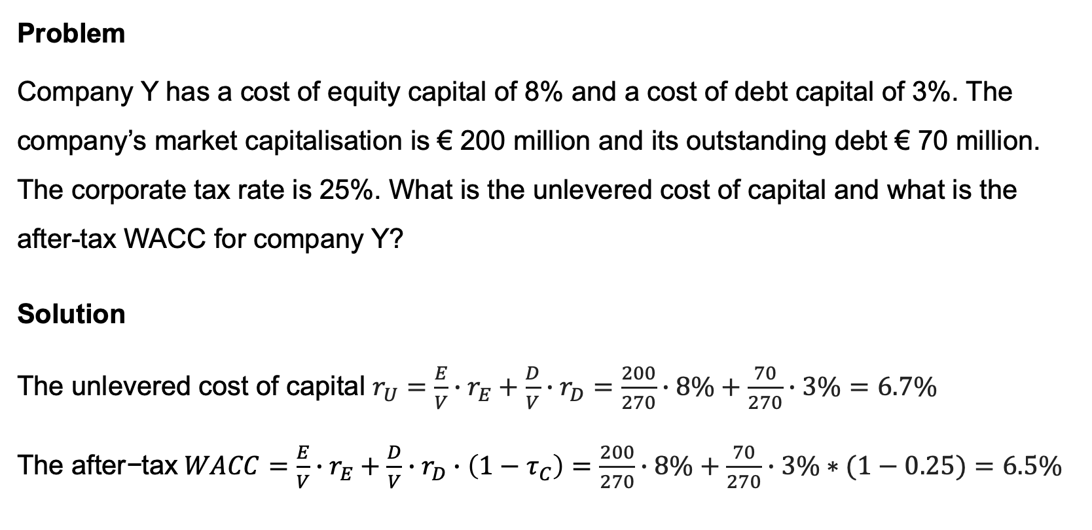
Calculating the WACC
Problem
Company Y has a cost of equity capital of 8% and a cost of debt capital of 3%. The company’s market capitalisation is € 200 million and its outstanding debt € 70 million. The corporate tax rate is 25%. What is the unlevered cost of capital and what is the after-tax WACC for company Y?
Solution
The unlevered cost of capital $r_{U}=\frac{E}{V}∙r_{E}+\frac{D}{V}∙r_{D}=\frac{200}{270}∙8\%+\frac{70}{270}∙3\%=6.7\%$
The $\text{after}\text{−}\text{tax} WACC=\frac{E}{V}∙r_{E}+\frac{D}{V}∙r_{D}∙\left(1−τ_{C}\right)=\frac{200}{270}∙8\%+\frac{70}{270}∙3\%∗(1−0.25)=6.5\%$

Slide 17


Project cost of capital
Company betas reflect the market risk of the average project in a company, but project risk can deviate substantially from company risk
Company betas $β_{E}$ are levered (i.e., they reflect the leverage of the companies), to get the unlevered beta $β_{U}$:
$$β_{U}=\frac{E}{E+D}∙β_{E}+\frac{D}{E+D}∙β_{D}$$
$$β_{U}$$
Industry betas for Norwegian salmon harvesting
vs MSCI World | 5-year monthly beta | 2-year weekly beta | E / (E + D) | Unlevered 5-year monthly beta | Unlevered 2-year weekly beta | Average beta
Bakkafrost | 0.41 | 0.48 | 0.77 | 0.32 | 0.37 | 0.34
SalMar | 0.31 | 0.21 | 0.67 | 0.21 | 0.14 | 0.17
Mowi | 0.70 | 0.46 | 0.63 | 0.44 | 0.29 | 0.36
Leroy Seafood | 0.55 | 0.58 | 0.71 | 0.39 | 0.41 | 0.40
Austevoll Seafood | 0.64 | 0.59 | 0.55 | 0.35 | 0.32 | 0.34
Grieg Seafood | 0.62 | 0.74 | 0.64 | 0.39 | 0.47 | 0.43
Norway Royal Salmon | 0.00 | 0.34 | 0.58 | 0.00 | 0.20 | 0.10
Average | 0.46 | 0.48 | 0.65 | 0.30 | 0.31 | 0.31
Median | 0.55 | 0.48 | 0.64 | 0.35 | 0.32 | 0.34
Average (without Royal) | 0.54 | 0.51 | 0.66 | 0.35 | 0.33 | 0.34

Slide 18
Project cost of capital
To calculate the project cost of capital
The first step is to find the relevant equity beta (from the specific industry)
The next step is from levered equity beta to unlevered asset beta (previous slide)
The final step is to select the relevant asset beta for the project
Project beta
Asset beta
(unlevered)
Debt beta
Equity beta
(levered)

Slide 19
Asset betas
Total Market 0.93
Source: Data from Damodaran (2022)

Slide 20
Calculating the project cost of capital
Problem
Pharma company X wants to build a new headquarters. It is fully financed with equity. The risk-free rate is 3% and the market risk premium is 4%. What is the project’s cost of capital?

Slide 21
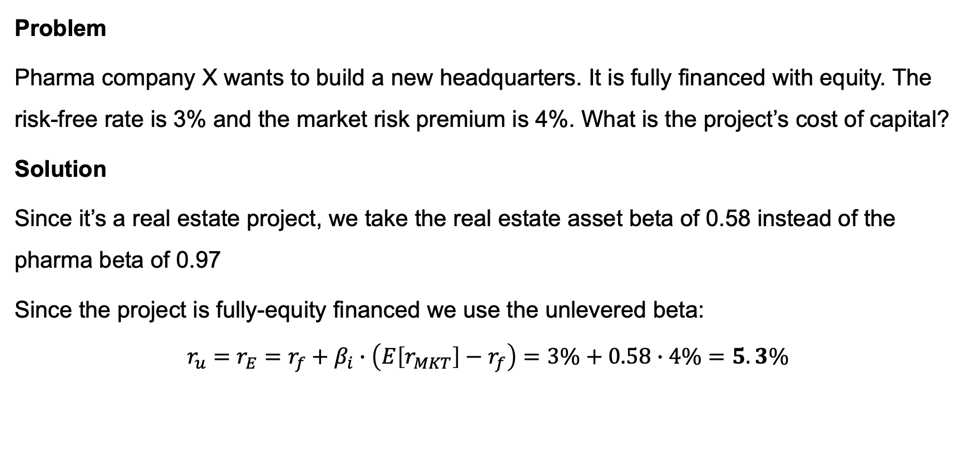
Calculating the project cost of capital
Problem
Pharma company X wants to build a new headquarters. It is fully financed with equity. The risk-free rate is 3% and the market risk premium is 4%. What is the project’s cost of capital?
Solution
Since it’s a real estate project, we take the real estate asset beta of 0.58 instead of the pharma beta of 0.97
Since the project is fully-equity financed we use the unlevered beta:
$$r_{u}=r_{E}=r_{f}+β_{i}∙\left(E\left[r_{MKT}\right]−r_{f}\right)=3\%+0.58∙4\%=5.3\%$$

Slide 22
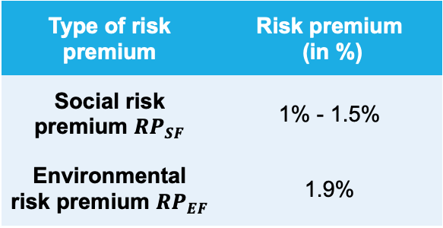
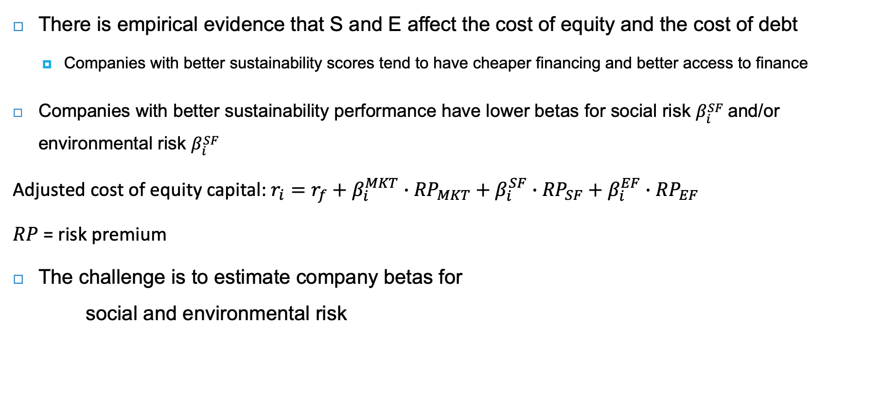
Adjusted cost of equity capital
There is empirical evidence that S and E affect the cost of equity and the cost of debt
  Companies with better sustainability scores tend to have cheaper financing and better access to finance
Companies with better sustainability performance have lower betas for social risk $β_{i}^{SF}$and/or environmental risk $β_{i}^{SF}$
Adjusted cost of equity capital: $r_{i}=r_{f}+β_{i}^{MKT}∙{RP}_{MKT}+β_{i}^{SF}∙{RP}_{SF}+β_{i}^{EF}∙{RP}_{EF}$
$RP$ = risk premium
The challenge is to estimate company betas for
social and environmental risk
Type of risk premium | Risk premium (in %)
Social risk premium ${RP}_{SF}$ | 1% - 1.5%
Environmental risk premium ${RP}_{EF}$ | 1.9%

Slide 23
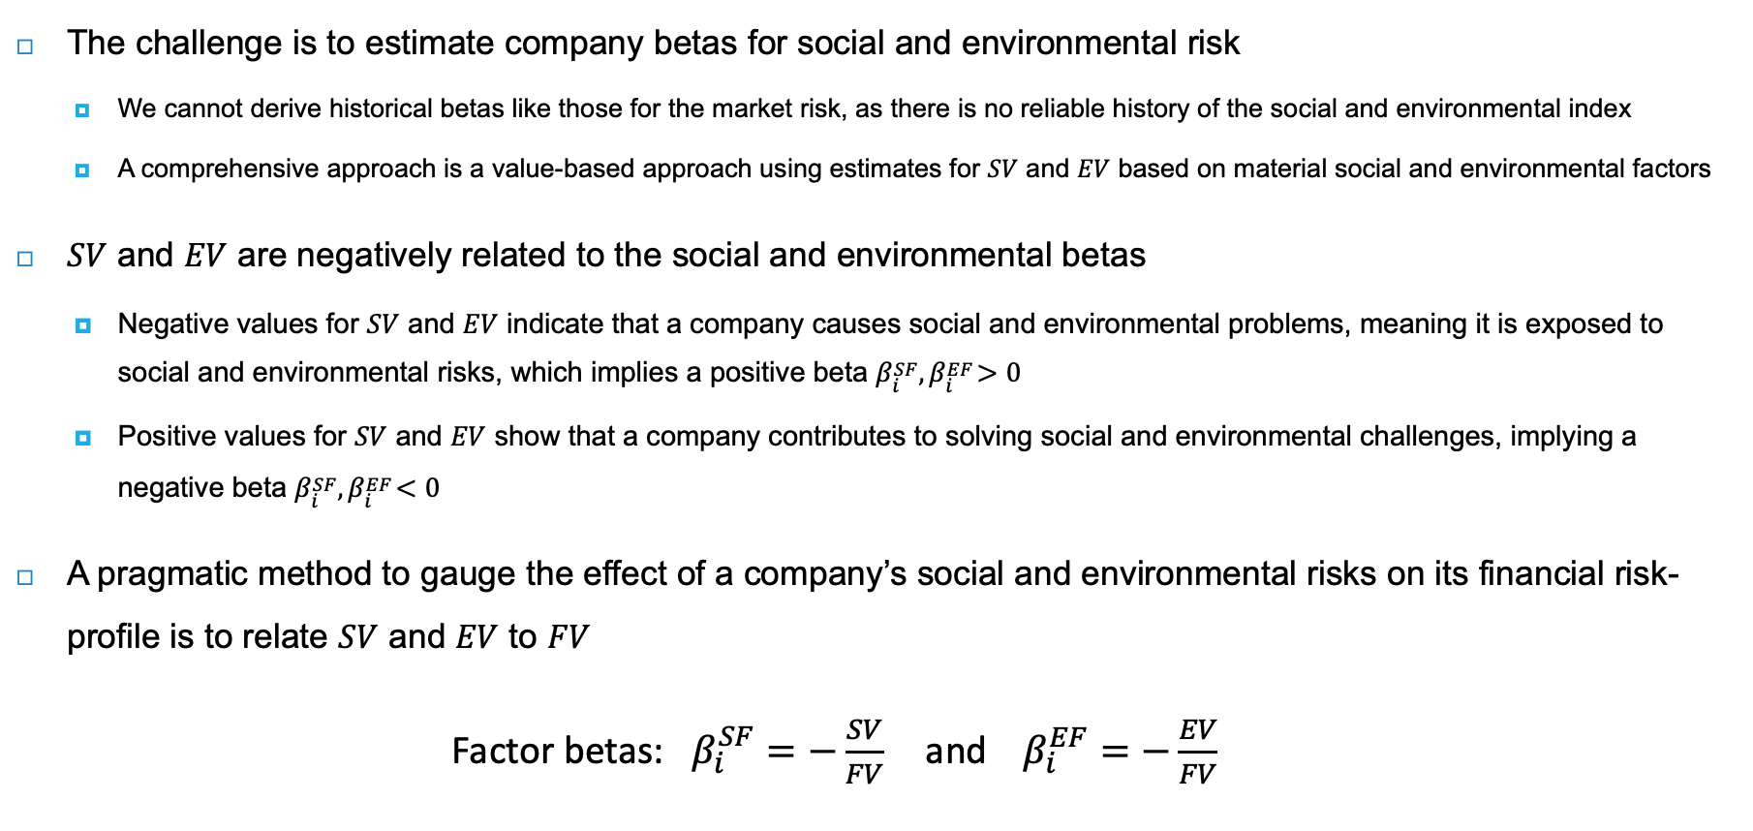
Estimating social and environmental betas
The challenge is to estimate company betas for social and environmental risk
  We cannot derive historical betas like those for the market risk, as there is no reliable history of the social and environmental index
  A comprehensive approach is a value-based approach using estimates for $SV$ and $EV$ based on material social and environmental factors
$SV$ and $EV$ are negatively related to the social and environmental betas
  Negative values for $SV$ and $EV$ indicate that a company causes social and environmental problems, meaning it is exposed to social and environmental risks, which implies a positive beta $β_{i}^{SF}, β_{i}^{EF}>0$
  Positive values for $SV$ and $EV$ show that a company contributes to solving social and environmental challenges, implying a negative beta $β_{i}^{SF}, β_{i}^{EF}<0$
A pragmatic method to gauge the effect of a company’s social and environmental risks on its financial risk-profile is to relate $SV$ and $EV$ to $FV$
Factor betas: $β_{i}^{SF}=−\frac{SV}{FV} \text{and} β_{i}^{EF}=−\frac{EV}{FV}$

Slide 24
Alternatives for estimating social and environmental betas
When data are not available to perform a complete calculation of SV and EV, you can make ad hoc assessments of the factor betas according to S and E exposures
Another approach uses ESG ratings:
  Low S and E scores indicate poor performance and higher exposure to S and E risks, so high betas, and vice versa: high S and E scores lead to low or even negative betas
  Given availability ESG ratings, this method is tempting
But ESG ratings have several drawbacks
  ESG ratings cannot be compared across industries
  No universal framework to define which ESG risks are material and should therefore be included
  Ratings only measure inward impact (single materiality) and not outword impact (double materiality)

Slide 25
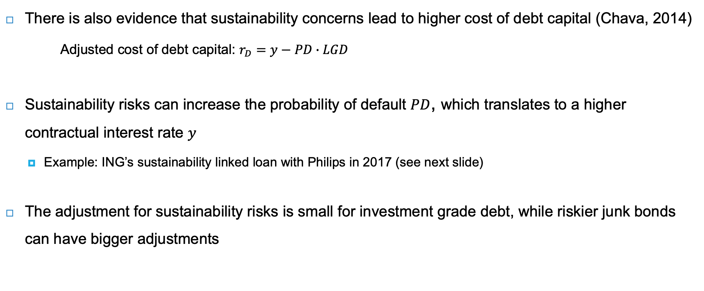
Adjusted cost of debt capital
There is also evidence that sustainability concerns lead to higher cost of debt capital (Chava, 2014)
Adjusted cost of debt capital: $r_{D}=y−PD∙LGD$
Sustainability risks can increase the probability of default $PD$, which translates to a higher contractual interest rate $y$
  Example: ING’s sustainability linked loan with Philips in 2017 (see next slide)
The adjustment for sustainability risks is small for investment grade debt, while riskier junk bonds can have bigger adjustments

Slide 26
Loan facility to Philips
Lead arranger of five-year loan facility
  Has conducted credit risk assessment; and
  Acts as sustainability coordinator in loan syndicate
A leading sustainable corporate
  ‘Healthy People, Sustainable Program’
ING
Philips
Loan
If sustainability performance up, interest rate goes down (and vice versa)
  Measured by Sustainalytics
  Up to 5-10% of credit spread
  (if spread 50 bps -> 2 to 5 bps)

Slide 27
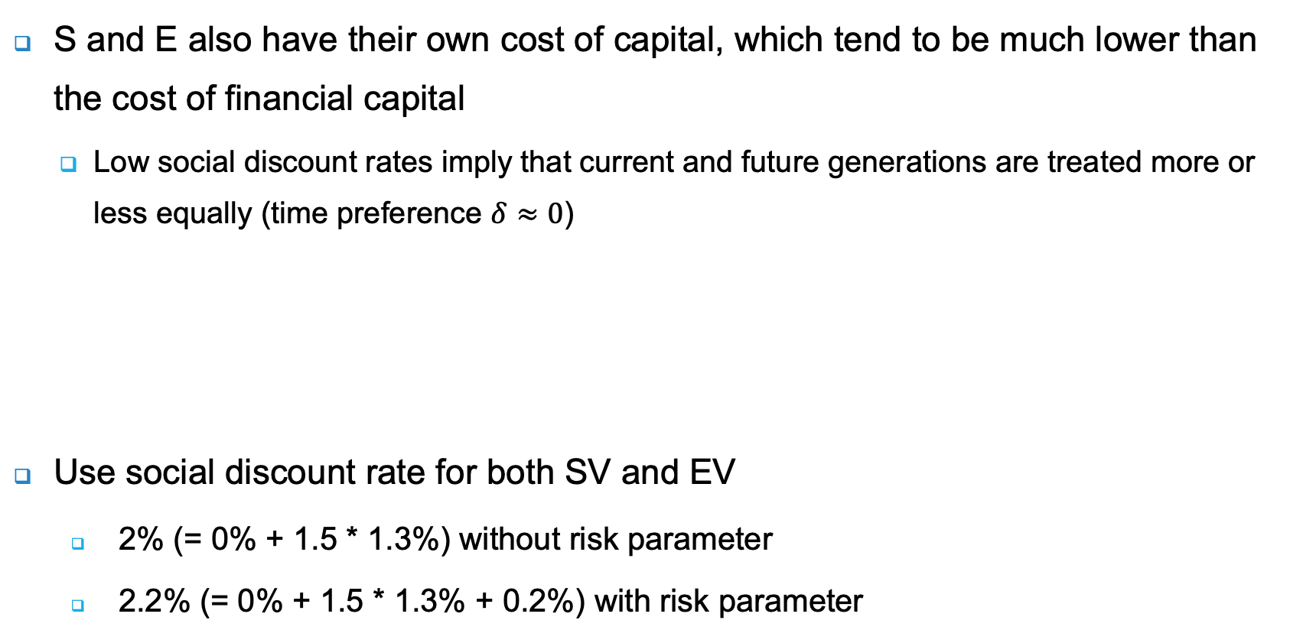
The cost of social and environmental capital
S and E also have their own cost of capital, which tend to be much lower than the cost of financial capital
  Low social discount rates imply that current and future generations are treated more or less equally (time preference $δ≈0$)
Use social discount rate for both SV and EV
  2% (= 0% + 1.5 * 1.3%) without risk parameter
  2.2% (= 0% + 1.5 * 1.3% + 0.2%) with risk parameter
Growth rate driven by growth in consumption
Reflects the extreme element of macroeconomic risk of rare disasters or society collapse

Slide 28
Applying the social discount rate
What does such a low cost of social and environmental capital mean?
  A lower cost of capital leads to a higher present value of social and environmental flows
Medtech company | Value in EUR millions
Financial flows
Annual cash flows (in EUR millions) | 450
Discount factor | 6.6%
Financial value (PV in EUR millions) | 6,818
Social flows
Quality life years extended annually | 2,000
Quality life year in EUR | 75,000
Annual social flows (in EUR millions) | 150
Discount factor | 2.2%
Social value (PV in EUR millions) | 6,818
Company value (in EUR millions) | 13,636
Oil company | Value in EUR millions
Financial flows
Annual cash flows (in EUR millions) | 800
Discount factor | 6.6%
Financial value (PV in EUR millions) | 12,121
Environmental flows
Carbon emissions (thousands of tonnes CO₂) | 1,800
Shadow price of emissions, EUR/tonne | 200
Annual environmental flows (in EUR millions) | -360
Discount factor | 2.2%
Environmental value (PV in EUR millions) | -16,364
Company value (in EUR millions) | -4,242
Environmental flows are 2x smaller than financial flows
Social flows are 3x smaller than financial flows
Social value is equal to financial value
Environmental value is larger than financial value
Positive SV leads to higher company value
Negative EV leads to lower company value

Slide 29
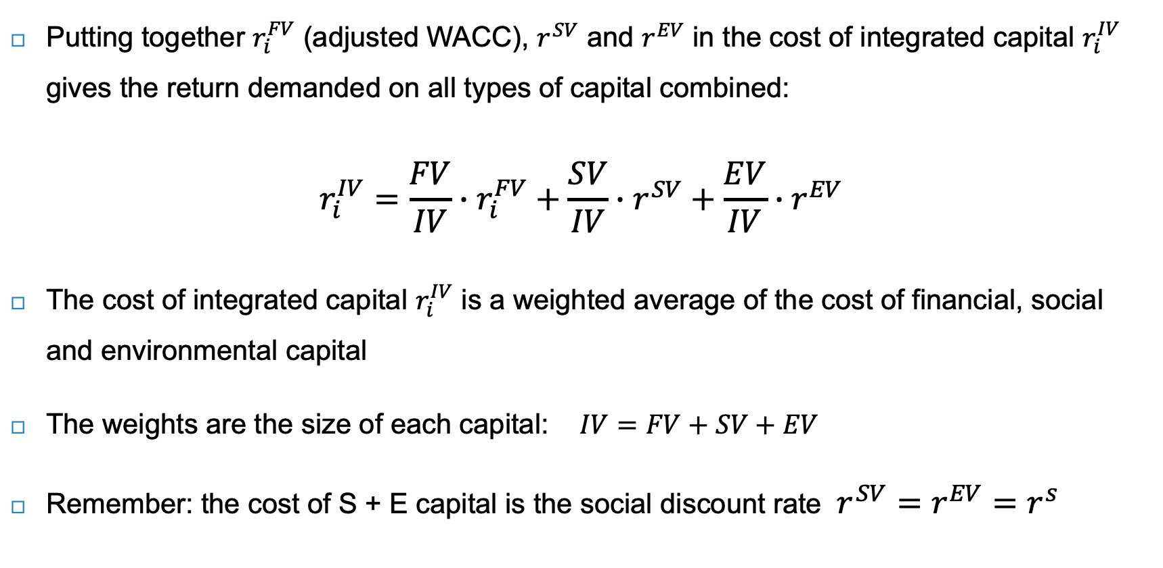
The cost of integrated capital
Putting together $r_{i}^{FV}$ (adjusted WACC), $r^{SV}$ and $r^{EV}$ in the cost of integrated capital $r_{i}^{IV}$ gives the return demanded on all types of capital combined:
$$r_{i}^{IV}=\frac{FV}{IV}∙r_{i}^{FV}+\frac{SV}{IV}∙r^{SV}+\frac{EV}{IV}∙r^{EV}$$
The cost of integrated capital $r_{i}^{IV}$ is a weighted average of the cost of financial, social and environmental capital
The weights are the size of each capital: $IV=FV+SV+EV$
Remember: the cost of S + E capital is the social discount rate $r^{SV}=r^{EV}=r^{s}$

Slide 30
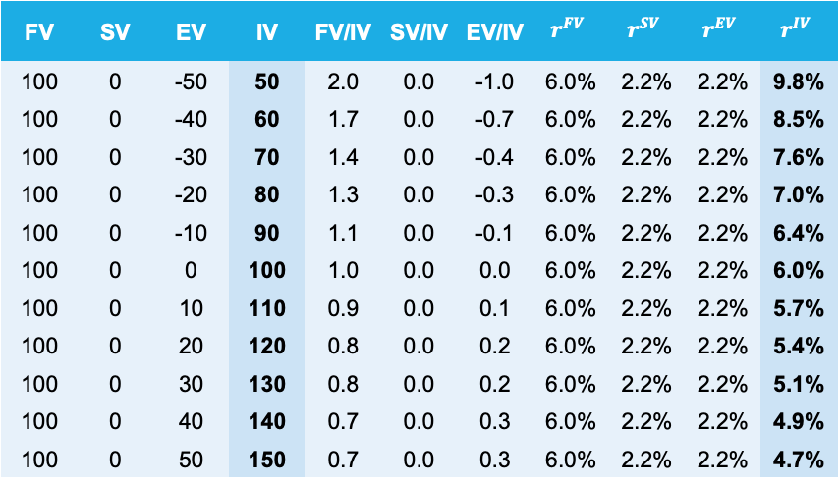

Cost of integrated capital in static setting
The cost of integrated capital: $r_{i}^{IV}=\frac{FV}{IV}∙r_{i}^{FV}+\frac{SV}{IV}∙r^{SV}+\frac{EV}{IV}∙r^{EV}$
The cost of integrated capital declines with higher amounts of social and environmental capital (assets) and rises when social and environmental capital falls and goes negative (liabilities)
FV | SV | EV | IV | FV/IV | SV/IV | EV/IV | $$r^{FV}$$ | $$r^{SV}$$ | $$r^{EV}$$ | $$r^{IV}$$
100 | 0 | -50 | 50 | 2.0 | 0.0 | -1.0 | 6.0% | 2.2% | 2.2% | 9.8%
100 | 0 | -40 | 60 | 1.7 | 0.0 | -0.7 | 6.0% | 2.2% | 2.2% | 8.5%
100 | 0 | -30 | 70 | 1.4 | 0.0 | -0.4 | 6.0% | 2.2% | 2.2% | 7.6%
100 | 0 | -20 | 80 | 1.3 | 0.0 | -0.3 | 6.0% | 2.2% | 2.2% | 7.0%
100 | 0 | -10 | 90 | 1.1 | 0.0 | -0.1 | 6.0% | 2.2% | 2.2% | 6.4%
100 | 0 | 0 | 100 | 1.0 | 0.0 | 0.0 | 6.0% | 2.2% | 2.2% | 6.0%
100 | 0 | 10 | 110 | 0.9 | 0.0 | 0.1 | 6.0% | 2.2% | 2.2% | 5.7%
100 | 0 | 20 | 120 | 0.8 | 0.0 | 0.2 | 6.0% | 2.2% | 2.2% | 5.4%
100 | 0 | 30 | 130 | 0.8 | 0.0 | 0.2 | 6.0% | 2.2% | 2.2% | 5.1%
100 | 0 | 40 | 140 | 0.7 | 0.0 | 0.3 | 6.0% | 2.2% | 2.2% | 4.9%
100 | 0 | 50 | 150 | 0.7 | 0.0 | 0.3 | 6.0% | 2.2% | 2.2% | 4.7%

Slide 31
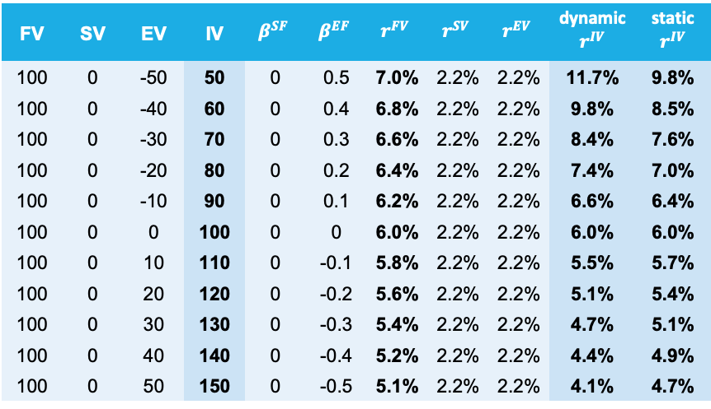

Cost of integrated capital in dynamic setting
The adjusted cost of financial capital $r^{FV}$ rises with increasing social and environmental risks
  The dispersion in the cost of integrated capital widens in a dynamic simulation
Social and environmental factors influence the adjusted cost of financial capital $r^{FV}$ in a limited way (5.1% to 7.0%), while the cost of integrated capital $r^{IV}$varies from 4.1% to 11.7%
FV | SV | EV | IV | $$β^{SF}$$ | $$β^{EF}$$ | $$r^{FV}$$ | $$r^{SV}$$ | $$r^{EV}$$ | dynamic $$r^{IV}$$ | static $$r^{IV}$$
100 | 0 | -50 | 50 | 0 | 0.5 | 7.0% | 2.2% | 2.2% | 11.7% | 9.8%
100 | 0 | -40 | 60 | 0 | 0.4 | 6.8% | 2.2% | 2.2% | 9.8% | 8.5%
100 | 0 | -30 | 70 | 0 | 0.3 | 6.6% | 2.2% | 2.2% | 8.4% | 7.6%
100 | 0 | -20 | 80 | 0 | 0.2 | 6.4% | 2.2% | 2.2% | 7.4% | 7.0%
100 | 0 | -10 | 90 | 0 | 0.1 | 6.2% | 2.2% | 2.2% | 6.6% | 6.4%
100 | 0 | 0 | 100 | 0 | 0 | 6.0% | 2.2% | 2.2% | 6.0% | 6.0%
100 | 0 | 10 | 110 | 0 | -0.1 | 5.8% | 2.2% | 2.2% | 5.5% | 5.7%
100 | 0 | 20 | 120 | 0 | -0.2 | 5.6% | 2.2% | 2.2% | 5.1% | 5.4%
100 | 0 | 30 | 130 | 0 | -0.3 | 5.4% | 2.2% | 2.2% | 4.7% | 5.1%
100 | 0 | 40 | 140 | 0 | -0.4 | 5.2% | 2.2% | 2.2% | 4.4% | 4.9%
100 | 0 | 50 | 150 | 0 | -0.5 | 5.1% | 2.2% | 2.2% | 4.1% | 4.7%
E Liabilities
E Assets

Slide 32

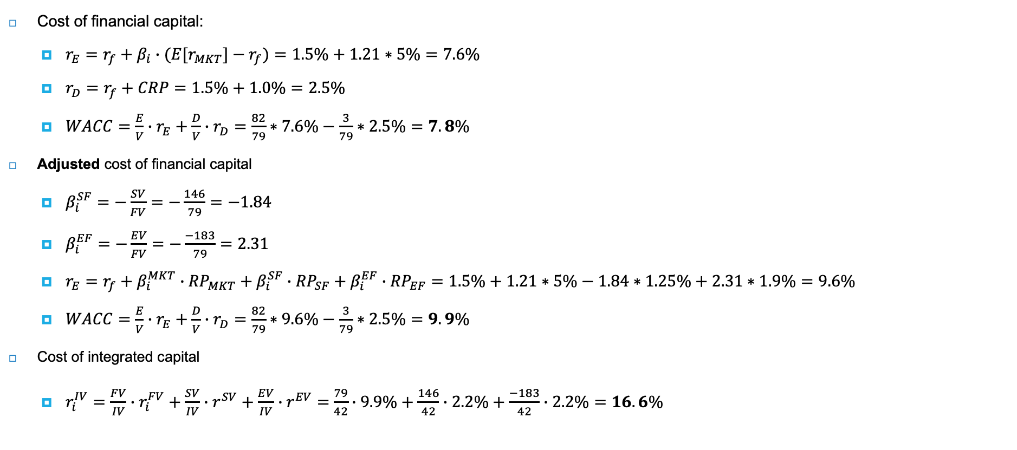
Inditex’s cost of integrated capital
Cost of financial capital:
  $r_{E}=r_{f}+β_{i}∙{(E[r}_{MKT}]−r_{f})=1.5\%+1.21∗5\%=7.6\%$
  $r_{D}=r_{f}+CRP=1.5\%+1.0\%=2.5\%$
  $WACC=\frac{E}{V}∙r_{E}+\frac{D}{V}∙r_{D}=\frac{82}{79}∗7.6\%−\frac{3}{79}∗2.5\%=7.8\%$
Adjusted cost of financial capital
  $β_{i}^{SF}=−\frac{SV}{FV}=−\frac{146}{79}=−1.84$
  $β_{i}^{EF}=−\frac{EV}{FV}=−\frac{−183}{79}=2.31$
  $r_{E}=r_{f}+β_{i}^{MKT}∙{RP}_{MKT}+β_{i}^{SF}∙{RP}_{SF}+β_{i}^{EF}∙{RP}_{EF}=1.5\%+1.21∗5\%−1.84∗1.25\%+2.31∗1.9\%=9.6\%$
  $WACC=\frac{E}{V}∙r_{E}+\frac{D}{V}∙r_{D}=\frac{82}{79}∗9.6\%−\frac{3}{79}∗2.5\%=9.9\%$
Cost of integrated capital
  $r_{i}^{IV}=\frac{FV}{IV}∙r_{i}^{FV}+\frac{SV}{IV}∙r^{SV}+\frac{EV}{IV}∙r^{EV}=$ $\frac{79}{42}∙9.9\%+\frac{146}{42}∙2.2\%+\frac{−183}{42}∙2.2\%=16.6\%$
IV calculation | Value
FV (enterprise value) | 79
Negative SV | -137
Positive SV | 283
Negative EV | -183
IV | 42
Risk-free rate, $r_{f}$ 1.5%
Mkt. risk premium, ${RP}_{MKT}$ 5%
Company beta, $β_{i}^{MKT}$ 1.21
Credit risk premium, $CRP$ 1%
Social risk premium, ${RP}_{SF}$ 1.25%
Env. risk premium, ${RP}_{EF}$ 1.9%

Slide 33
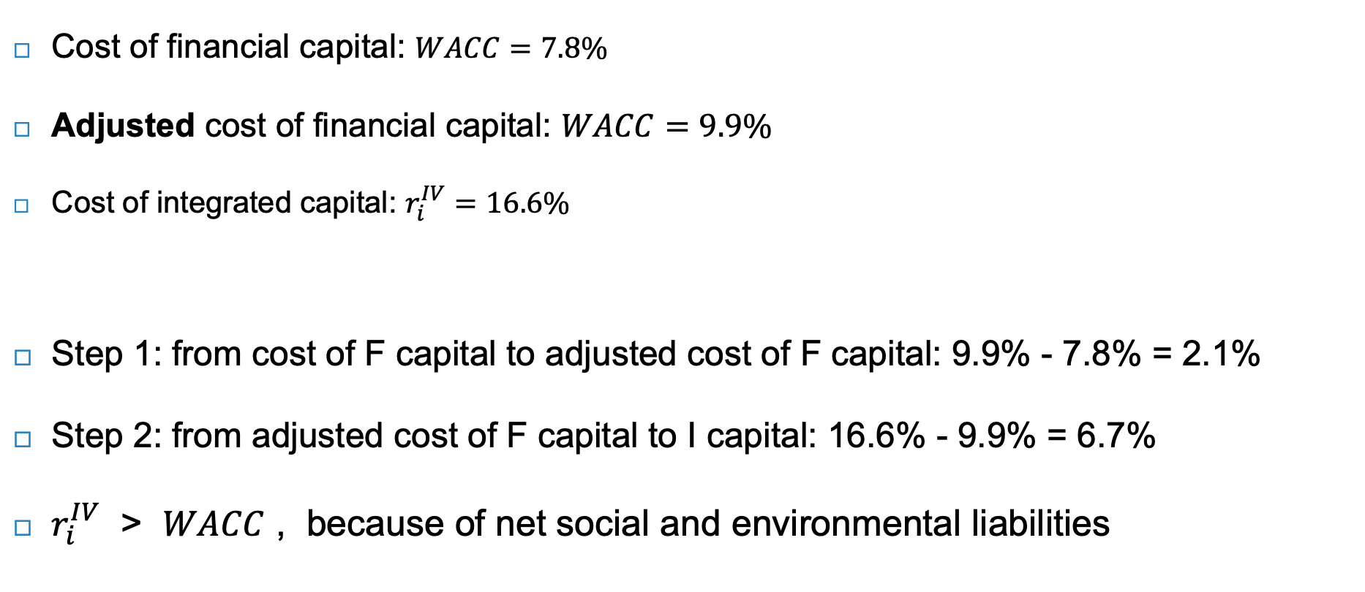
Inditex’s cost of integrated capital - interpretation
Cost of financial capital: $WACC=7.8\%$
Adjusted cost of financial capital: $WACC=9.9\%$
Cost of integrated capital: $r_{i}^{IV}=16.6\%$
Step 1: from cost of F capital to adjusted cost of F capital: 9.9% - 7.8% = 2.1%
Step 2: from adjusted cost of F capital to I capital: 16.6% - 9.9% = 6.7%
$r_{i}^{IV}$ > $WACC$ , because of net social and environmental liabilities
IV calculation | Value
FV (enterprise value) | 79
Negative SV | -137
Positive SV | 283
Negative EV | -183
IV | 42

Slide 34
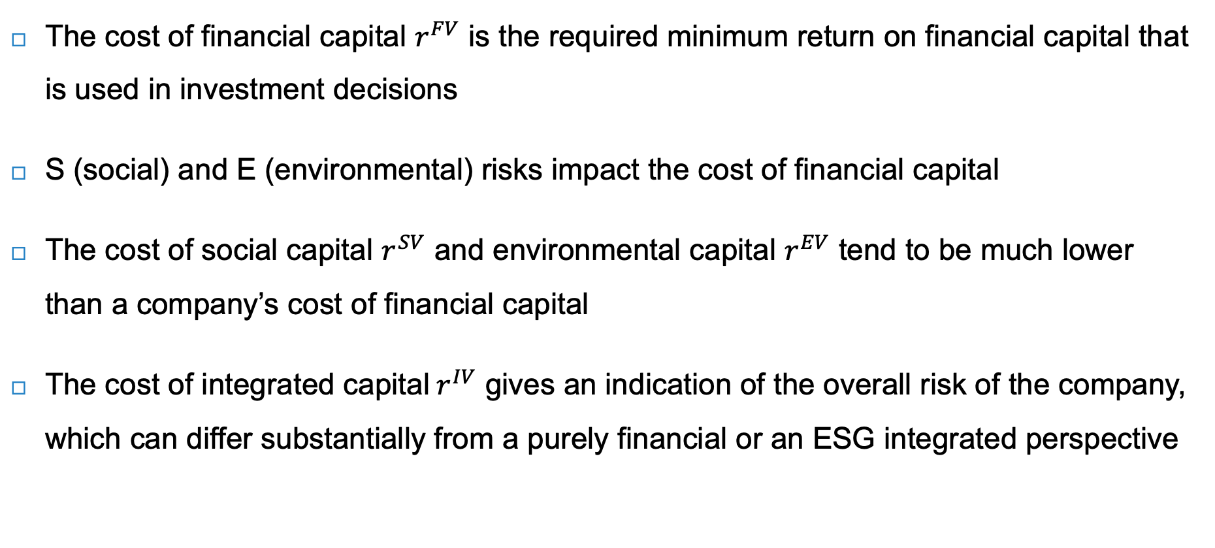
Conclusions
The cost of financial capital $r^{FV}$ is the required minimum return on financial capital that is used in investment decisions
S (social) and E (environmental) risks impact the cost of financial capital
The cost of social capital $r^{SV}$ and environmental capital $r^{EV}$ tend to be much lower than a company’s cost of financial capital
The cost of integrated capital$r^{IV}$ gives an indication of the overall risk of the company, which can differ substantially from a purely financial or an ESG integrated perspective

